Slide 1

CoastWA Training
CHRMAP Implementation
Presented by
Anna Kelderman, Shape Urban

Slide 3
Prepared via stakeholder discussions and Research…
CHRMAP’s and supporting documents from LGAs:
Albany
Augusta-Margaret River
Broome
Bunbury (CHRMAP final, summary draft)
Busselton
Cambridge
Cockburn
Cocos (Keeling) Islands (draft)
Dandaragan
Denham
Denmark
Geraldton
Gingin (draft)
Harvey
Joondalup
Karratha
Mandurah (Northern Beaches)
Murray (draft)
Onslow
Port Hedland
Rockingham
Notes:
Albany
Bunbury
Busselton
Capel
Cockburn
Mandurah
Joondalup
Gingin
Also, DPLH, DoT, Port Hedland, Broome, Fremantle, Harvey, Hopetoun, Dardanup, WA Community and Marine Network, UWA Centre for Environmental Economics and Policy and others

Slide 4

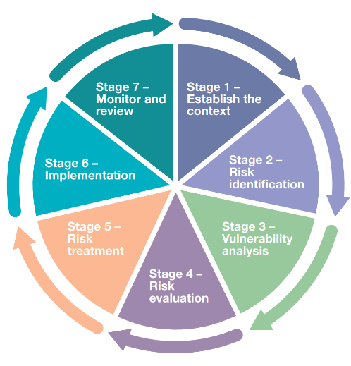
A QUICK FRAMING

Slide 5
WHAT IS CHRMAP
Coastal Hazard
  What are they
Risk Management
  What are we responding to / what are we concerned about
Adaptation
  What are the options to respond
Plan
  What do we do next
May be the last word, but it’s not the least….
Notes:
Do quick interaction session here – check everyone can say it in person / online, do a quick audit of people who’ve written a CHRMAP / had to use Imp Sect.
It is why it sits within the planning framework

Slide 6
CHRMAP
A strategic PLAN to meet coastal hazard challenges…
Informs community and decision makers
A plan for 100 years
Notes:
Sits within the planning framework for a good reason!

Slide 7
In short, the implementation section is the section that ultimately defines action, and may be the primary reference section for most users…
Notes:
Prior to this section, a user may be able to infer the suggested approaches, but it is unlikely they will be able to draw concrete conclusions.

Slide 8
4
The number of stakeholders who explicitly said they wished they knew this
6
The number of stakeholders who said they wished they had involved more directorates
Notes:
Who wished they knew how important the section was – unprompted - 4 – Bunbury, Albany, Cockburn, Mandurah
Who wished they had involved more directorates in developing the implementation section - 6 - Bunbury, Albany, Busselton, Cockburn, Mandurah, Joondalup
Wished the scope of works made this part more specific

Slide 9
Most ‘real’ people will only want to know what’s in/read this section

Slide 10
Most ‘real’ people will only want to know what’s in/read this section; it has to be understandable, and the next steps should be very clear
Notes:
This is particularly true if the CHRMAP is suggesting long term treatment that is quite controversial - especially this type of recommendation will take years to deliver.

Slide 11
4
The number of stakeholders who ended up developing a summary document to make it easier to understand (including specifically the implementation sections)
3
The number of stakeholders who are planning to develop a summary document to make it easier to understand
Notes:
Albany, Bunbury, Capel, Gingin - Rockingham, Cambridge, Mandurah
Plus nearly all new scopes including it – Cocos and Mandurah Southern Beaches will have the same

Slide 12
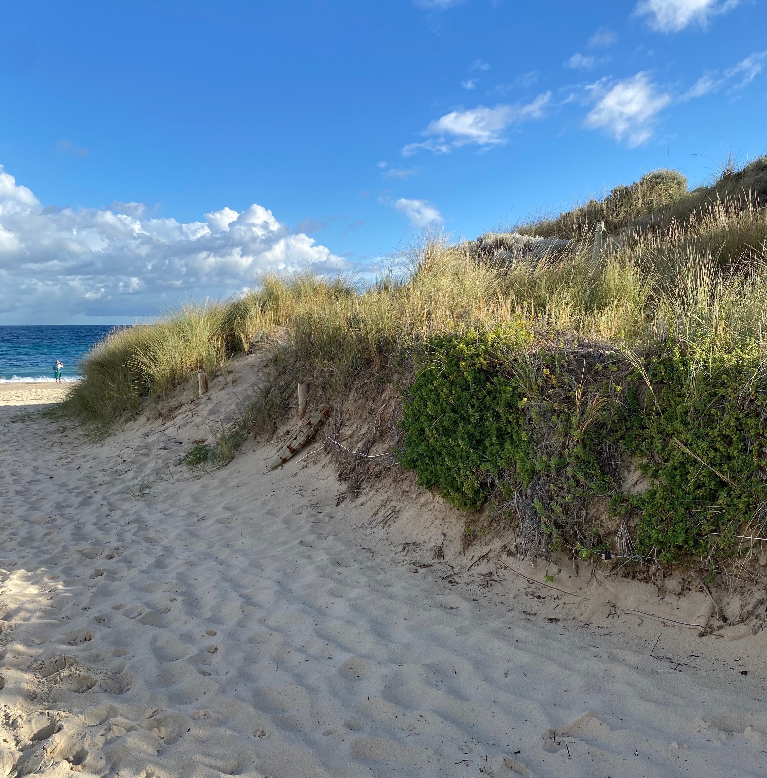
THIS TRAINING SESSION

Slide 13
What is the purpose of this training?
Introductions and Framing
What should a CHRMAP Implementation Plan include, including:
  Planning, monitoring, investigations, studies (examples)
  Funding information
  Challenges faced
  How to communicate
Common actions in a CHRMAP Implementation Plan
Success stories and suggestions
Notes:
What should a CHRMAP Implementation Plan include
Examples of CHRMAP IP
Common actions in a CHRMAP Implementation Plan
Prioritising actions and recommendations
Funding implementation and local government mechanisms for raising funds, equity of funding arrangements for coastal protection works
Challenges associated with CHRMAP implementation and what are the potential solutions
Unfortunately for you all this section of the CHRMAP Implementation Section has less images and fun things to look at – so I apologise in advance for the number of slides with words. I’ve thrown in a few palate cleansers just to spark some joy.

Slide 14
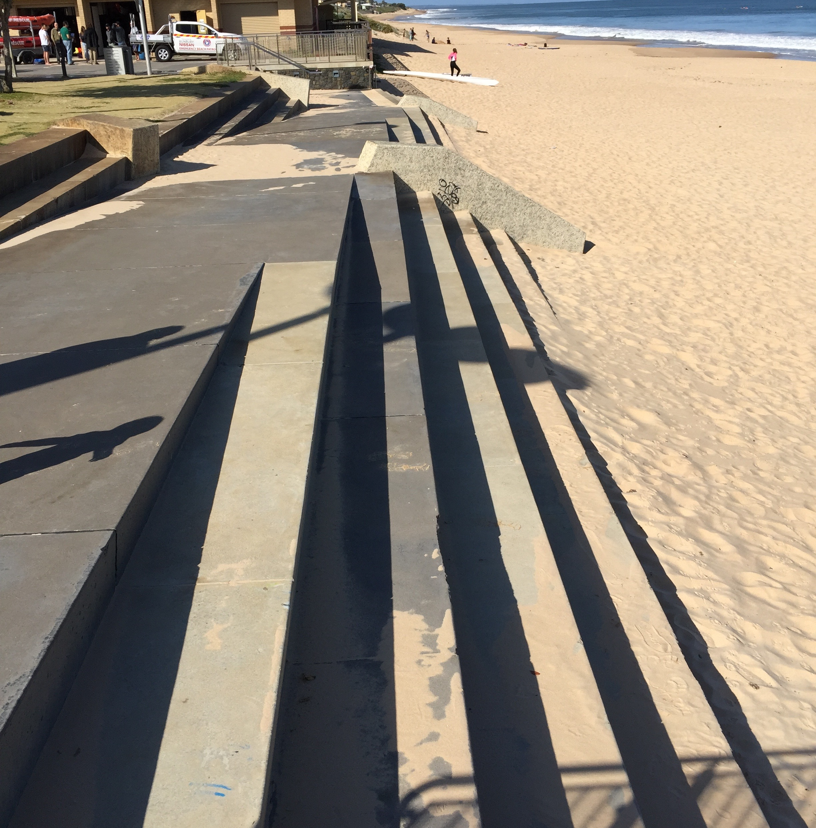
THE CASE FOR A CLEAR IMPLEMENTATION
SECTION

Slide 15
What is the value of the implementation section?
Implementation is the ‘So What?’; next steps, action
Who does what, by when
Making the technical, less technical
Not everyone will have been involved
Notes:
The Implementation Section is the ‘So What?’, the next steps, the action plan
Not all coastal managers are across all the technical details
Not everyone impacted by the CHRMAP will have been involved in developing it and that can include staff turnover, other directorates, and even community members

Slide 16
Who uses it?
Coastal managers
Users of the coast
Developers
Designers
People
Notes:
Coastal managers – engineers, scientists, planners, CEO’s, Elected Members, community development teams
Users of the coast – surf clubs, boat ramp/harbour managers, Coast Care / NRM / environmental groups
Developers – planners, urban designers, engineers
Designers – landscape architects, architects, planners
People – property owners, buyers, sellers, agents, investors
It is obviously for this reason that the documents need to be accessible to all possible users

Slide 17
A good implementation section…
States clearly what will happen next (the first next steps) in order of priority*
Indicates later steps conditionally
Is free of too much jargon
Is laid out simply and clearly
Reflects the flexible nature of CHRMAPs
Notes:
Priority of action is a funny thing – the first thing started may not be the first thing implemented
Flexible nature of. CHRMAP and italicised conditionally – careful that CHRMAP does not build too many expectations
Good to list easy wins first, things that are not unexpected, those short term, softer solutions, and then build up to the more complex.
The ‘who’ (discipline area, technical specialty) implements the CHRMAP does not shift the need to have a communication mindset. When people don’t understand something, they ignore it or make their own conclusions.

Slide 18
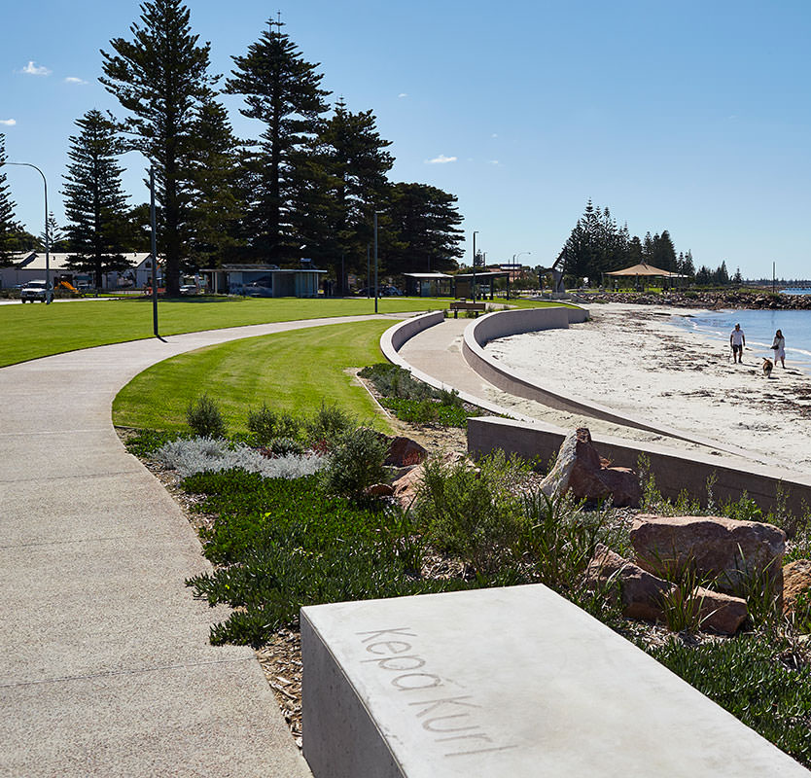
REQUIREMENTS

Slide 19

Where do I find what is needed?
https://www.wa.gov.au/government/publications/wa-coastal-zone-strategy
Notes:
Really important for setting high level objectives. States clearly who is responsible for what and where coastal protection is proposed, under what conditions

Slide 20
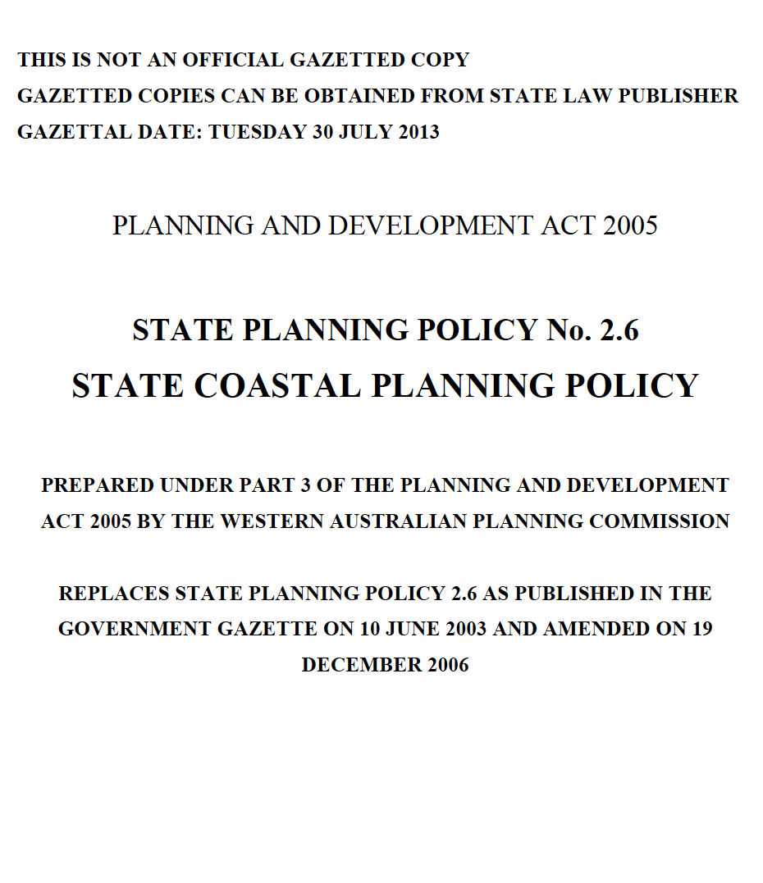

Where do I find what is needed?
https://www.wa.gov.au/government/publications/state-planning-policy-26-coastal-planning

Slide 21
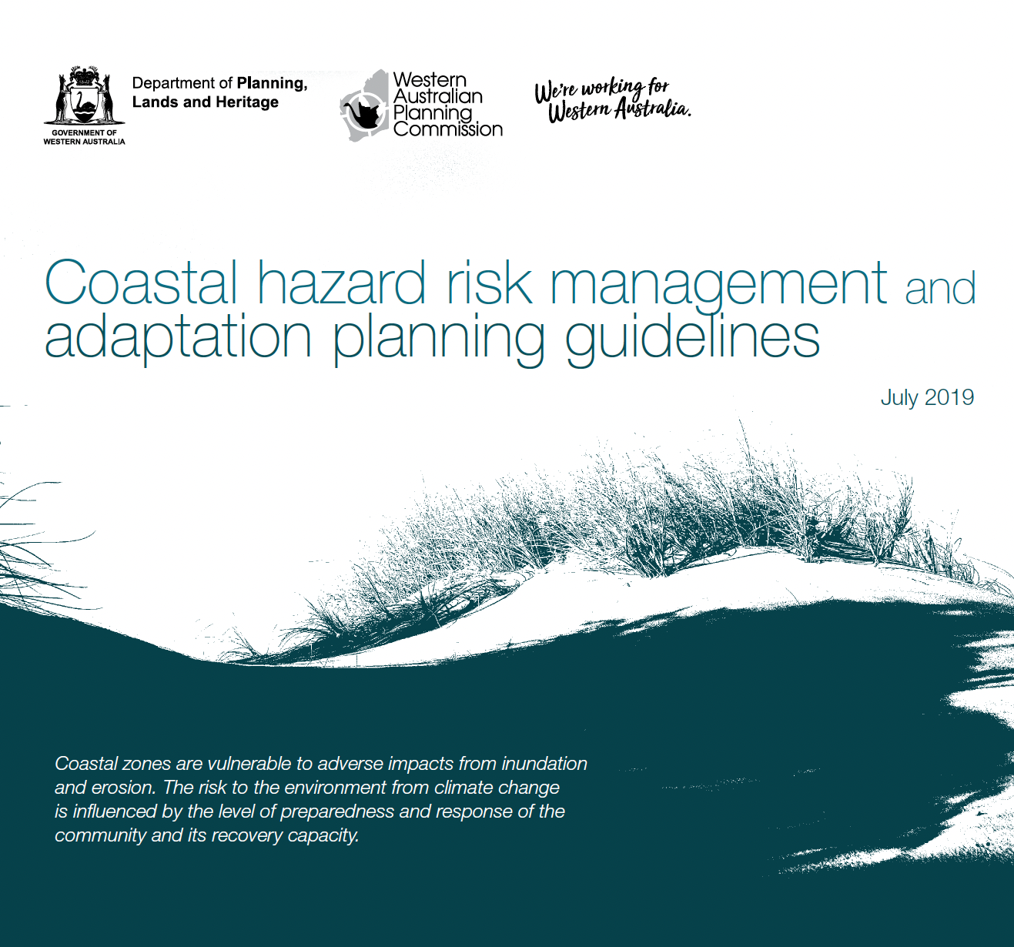
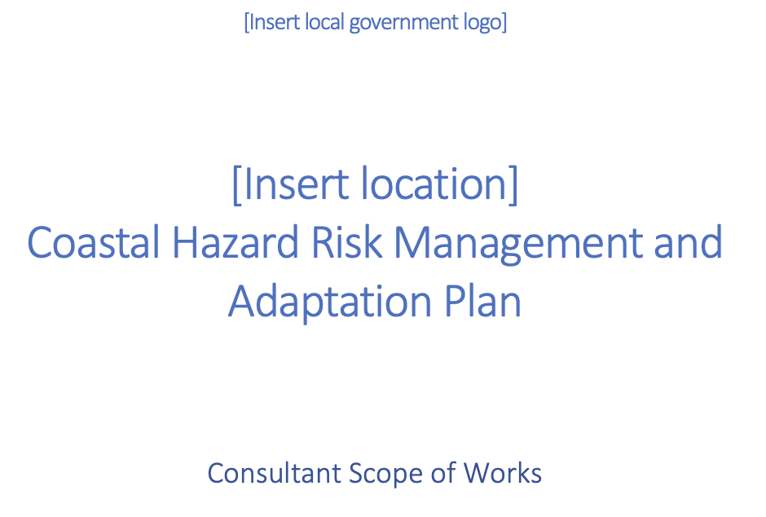
Where do I find what is needed?
https://www.wa.gov.au/government/document-collections/coastal-hazard-risk-management-and-adaptation-planning-guidelines

Slide 22
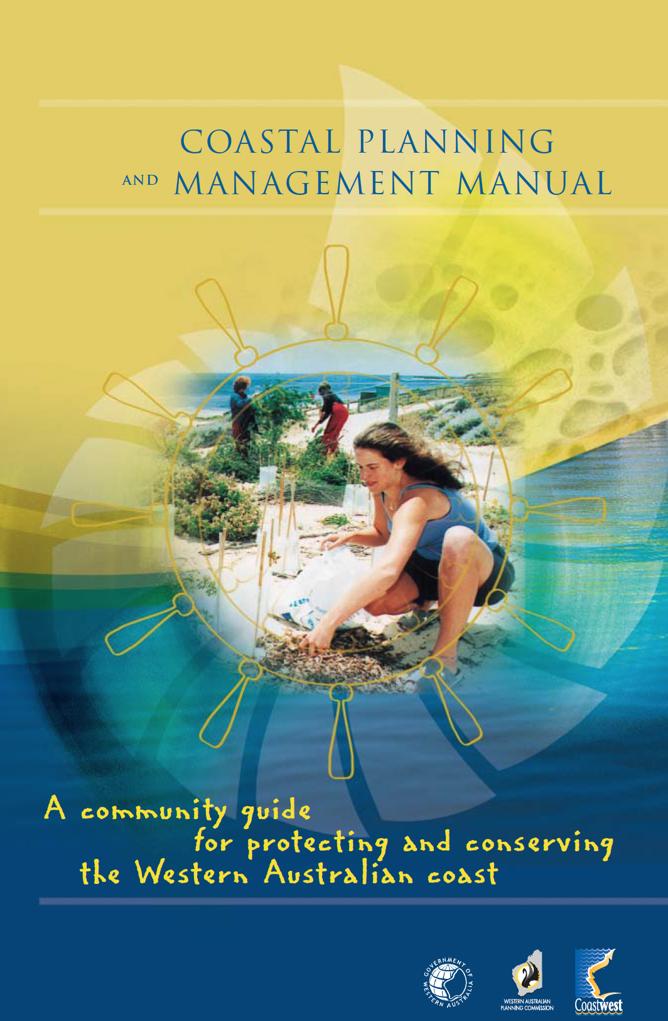
An aside…
This 2003 document is full of tips and tricks that are still relevant today:
Indigenous participation
Common coastal management problems
Stabilisation and rehabilitation
Revegetation
Notes:
Although pretty ageing now, and not directly related to our content, there is some information in this manual that could perhaps influence some of your implementation recommendations.
Particularly significant relating to common problems – this is likely to give a good sense of some of the stakeholders who will be interested in the long term implications of the CHRMAP!
Also on the main website of SPP 2.6

Slide 23
Quick reminder…
Follows Stage 5 (Risk Treatment) and a number of previous tasks
Notes:
Stage 5 – Does a lot of heavy lifting for the implementation section. A well set up Stage 5 report section can reduce extent of this chapter.
Previous tasks are defined in the consultant scope of works but go into detail in Stage 5 about the options available… If not well described previously there can be a lot of extra explanation in this task.

Slide 24
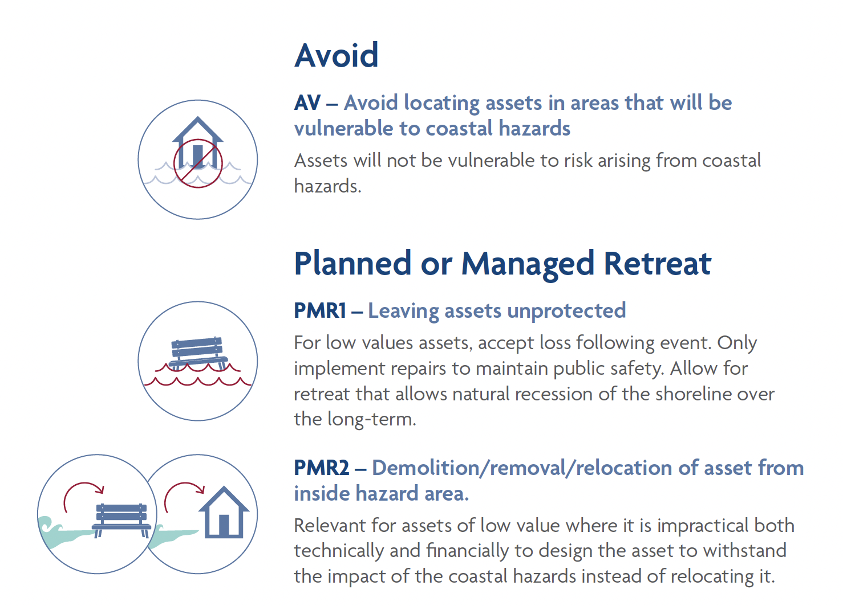
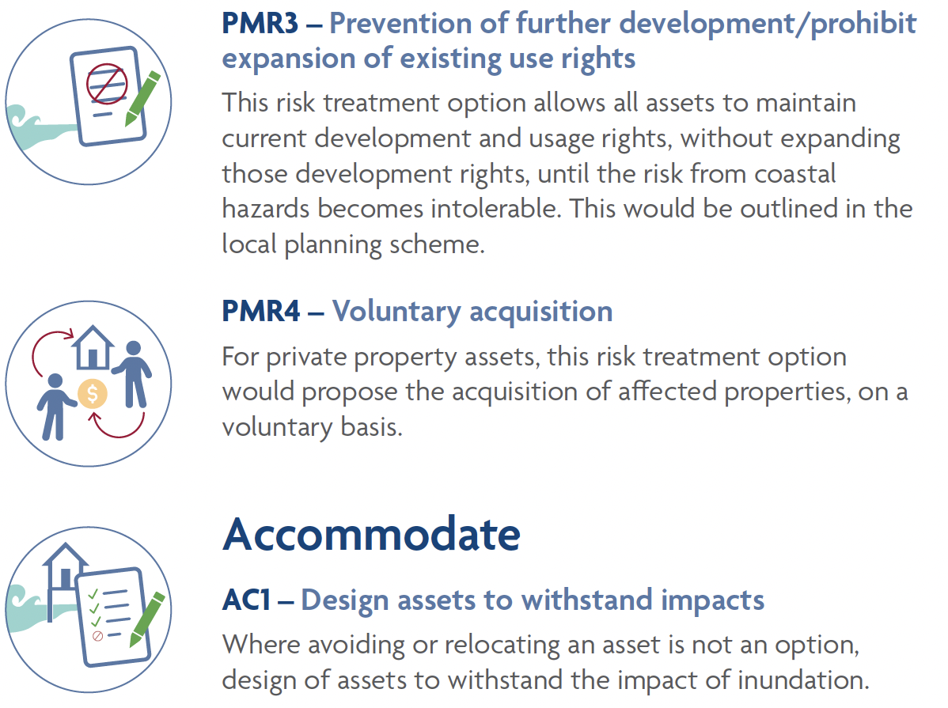
Source: City of Bunbury
Notes:
Some examples of the things we would have just discussed in Stage 5

Slide 25
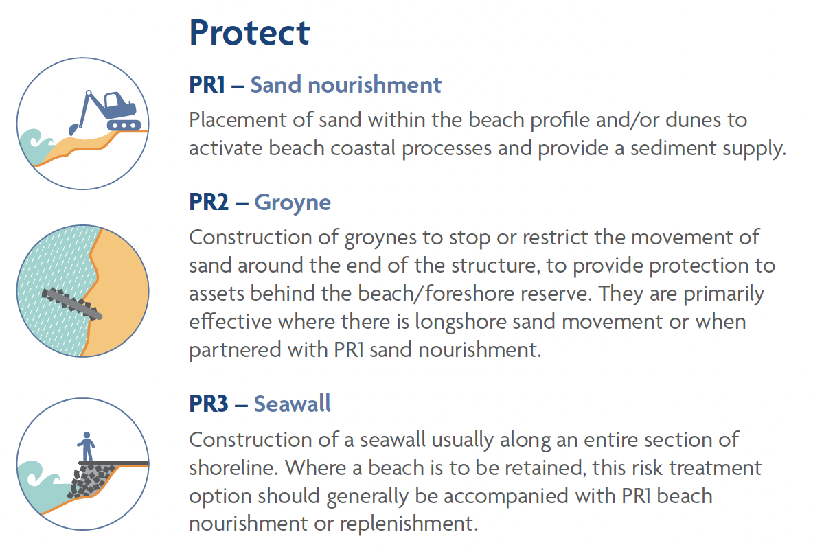
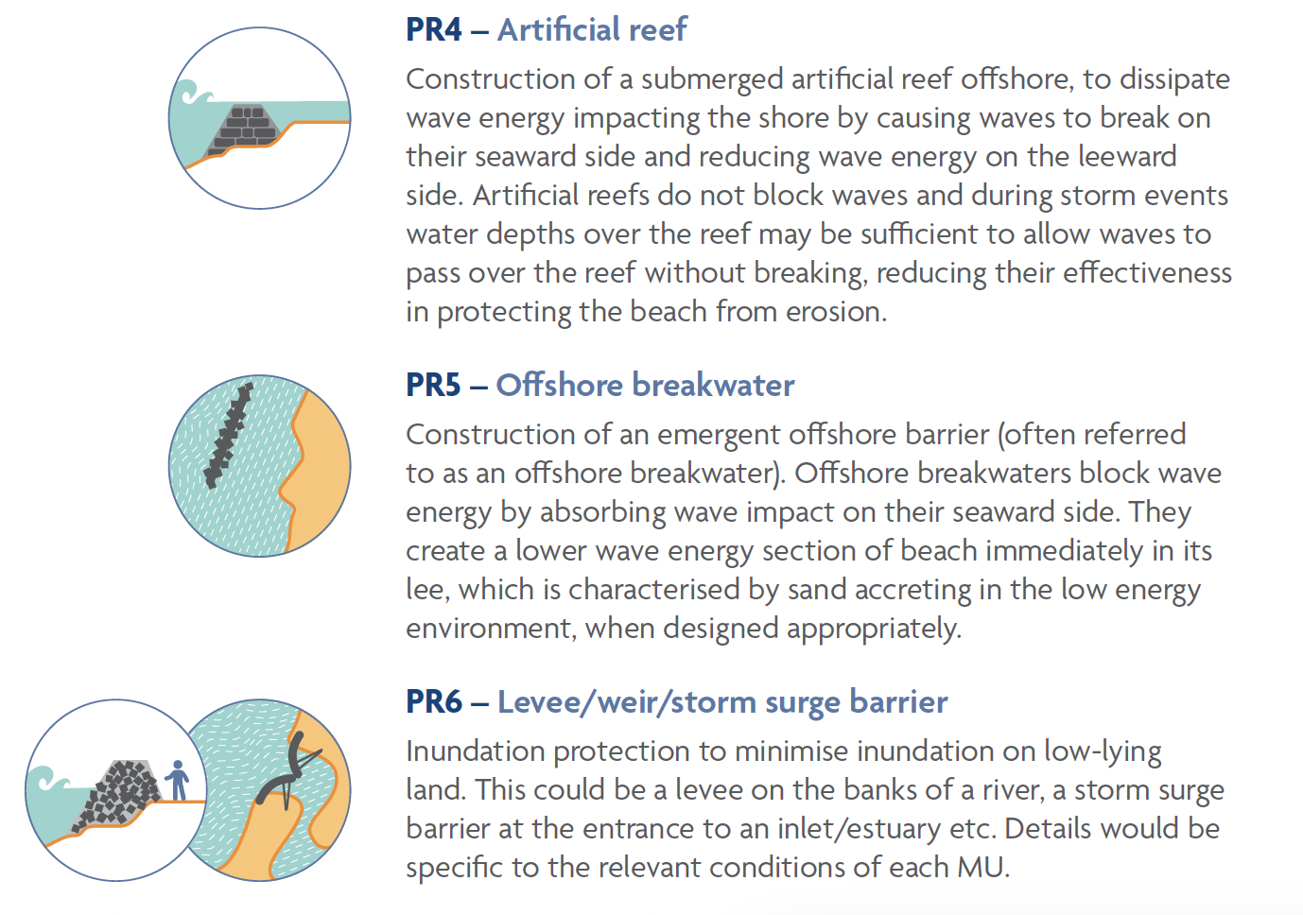
Source: City of Bunbury
Notes:
Some examples of the things we would have just discussed in Stage 5

Slide 26
The CHRMAP Guidelines say…
Follows Stage 5 (Risk Treatment) previous tasks
Stage 6 includes:
Short Term Implementation
Medium and long-term Implementation Plan
Land Use Planning Instruments
Funding
Notes:
Stage 5 – Does a lot of heavy lifting for the implementation section. A well set up Stage 5 report section can reduce extent of this chapter.

Slide 27
One more thing…
Monitor and Review follows Stage 6
Stage 7 includes:
Monitoring
Notes:
I m mentioning this, as this stage is regularly integrated into the Stage 6/Implementation Plan reporting, given that the typical scope of works includes many of the same elements/requirements

Slide 28
The CHRMAP Guidelines say…
For Short Term Implementation:
What is selected; options/s and why
Resources to implement
Responsibility
Approval agencies
Trigger
Cost
Performance Indicator
Communication and Monitoring

Slide 29
The CHRMAP Guidelines say…
Stage 6 – Implementation Plan
The template scope of works says:
A 25-year implementation plan is to be developed for each asset, groups of assets or sector, in accordance with the CHRMAP Guidelines. The assets can be grouped, but the same grouping as identified in the medium and long-term pathways is to be used
Notes:
A 25-year implementation plan is to be developed for each asset, groups of assets or sector, in accordance with the CHRMAP Guidelines. The assets can be grouped, but the same grouping as identified in the medium and long-term pathways is to be used

Slide 30
The CHRMAP Guidelines say…
What is selected; options/s and why
The template scope of works says:
What is the required risk management measure to implement the risk treatment option? The reasons for selection, including expected benefits to be gained.
Notes:
Task described as…
Recognising that much of this is discussed and unpacked in the previous Stage

Slide 31
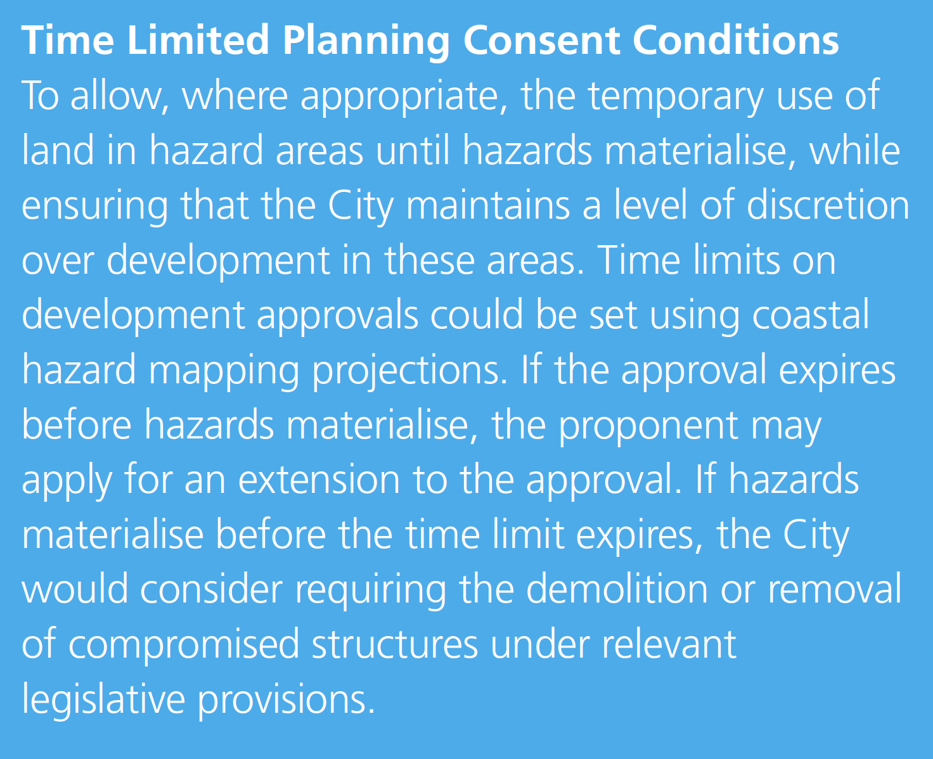
Required option
Expected benefits
Reason for selection
Source: City of Rockingham
Notes:
Example – Description of one tool which describes the benefit of including a short term action
Feedback from stakeholders indicated a desire to understand where recommendations had been successfully implemented – it’s worth noting that ‘TIME’ limited planning conditions have been tested by a few local governments, and the feedback (including legal appeals decisions) is that using ‘EVENT’ limited conditions is more enforceable/less likely to be successfully appealed.
The Shire of Gingin, City of Joondalup and a number of other LGAs are already using SPP 2.6 to deliver this particular recommendation, in most cases, before the advent of the Special Control Area or policy in place.

Slide 32
The CHRMAP Guidelines say…
Resources to implement
The template scope of works says:
What is required to implement the risk management measure?
Notes:
This is often included in Implementation as the short term actions.
A number of stakeholders suggested that the implementation of the CHRMAP required more consideration about a dedicated resource – where resource is more about staffing.
Whilst such an outcome may be impossible for some coastal managers to achieve, it is at least worth understanding the implications.
The resource intensity does not seem to be limited by population or coastal intensity – more by the quantity of actions required.

Slide 33
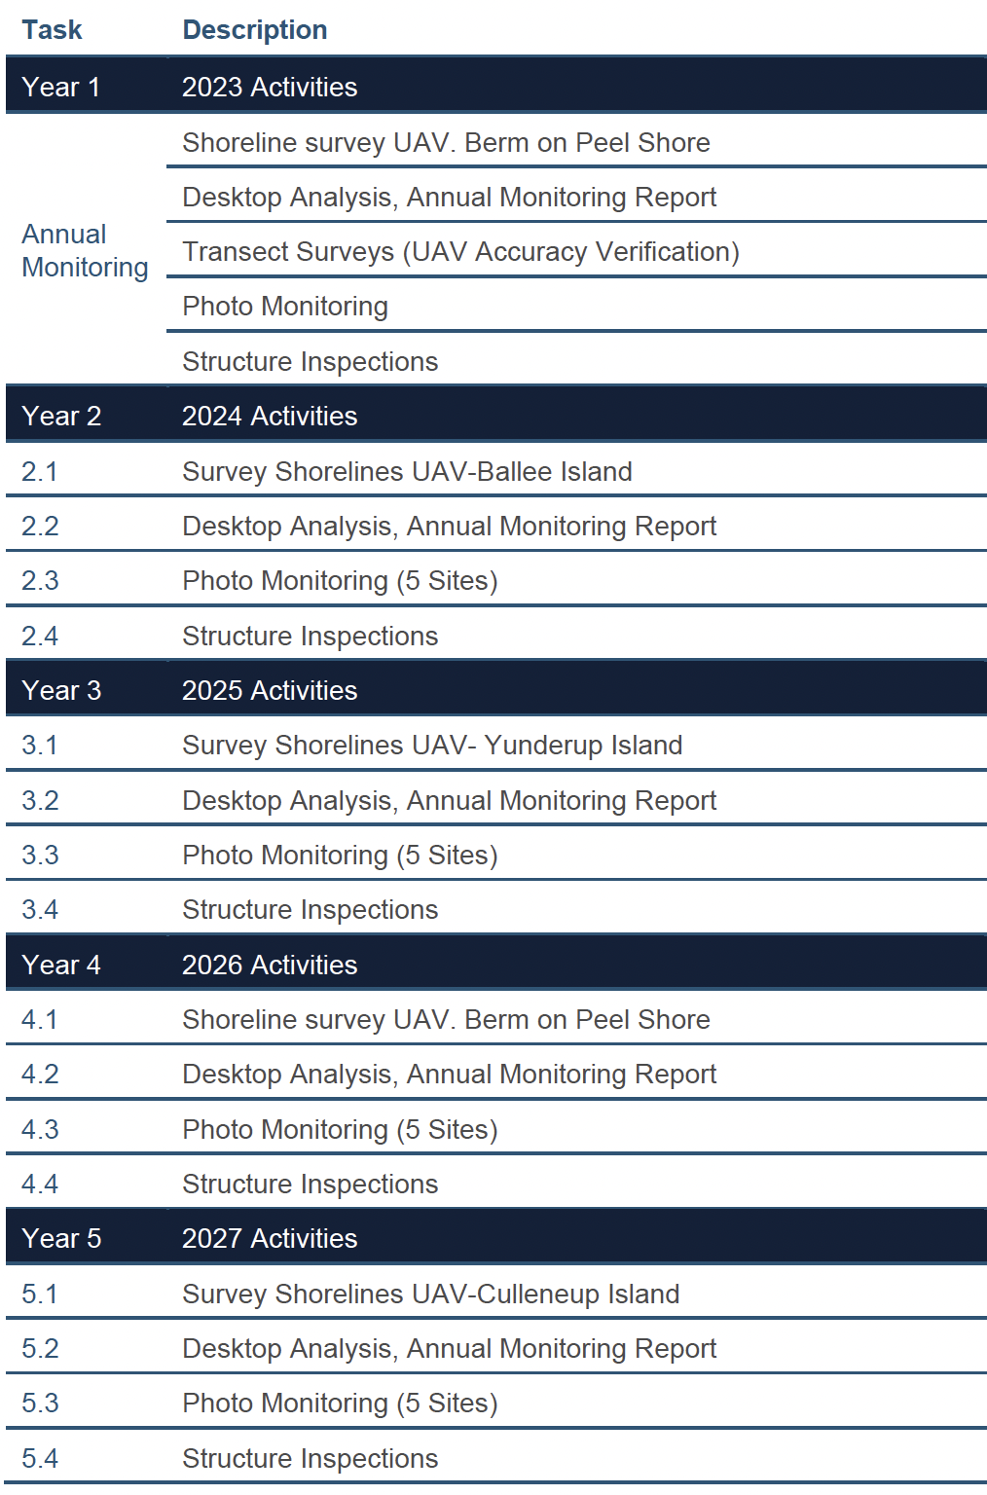
Source: Shire of Murray
Notes:
This example shows a very detailed, year on year strategy for monitoring, which will underpin the final adaptation pathway. In this Shire of Murray document, monitoring of a number of areas is required to determine the right time for decision making of more substantial investment. This table provides very specific detail of a five-year program across multiple sites.
Two things to note on this case study, is that the specificity of the dates may be too optimistic and perhaps the CHRMAP is already behind. It is desirable to allow for some flexibility, noting that funding and grants may not be available in order to achieve such strict timeframes, or the availability of personnel.
Notwithstanding, the Shire of Murray is also home to a great example of collaboration to achieve affordable outcomes. Murray is partnering with UWA, with a Master of Environmental Engineering Student delivering their monitoring program for a fraction of the normal price.

Slide 34
The CHRMAP Guidelines say…
Responsibility
The template scope of works says:
Who will be responsible for the implementation (risk management owner)?

Slide 35
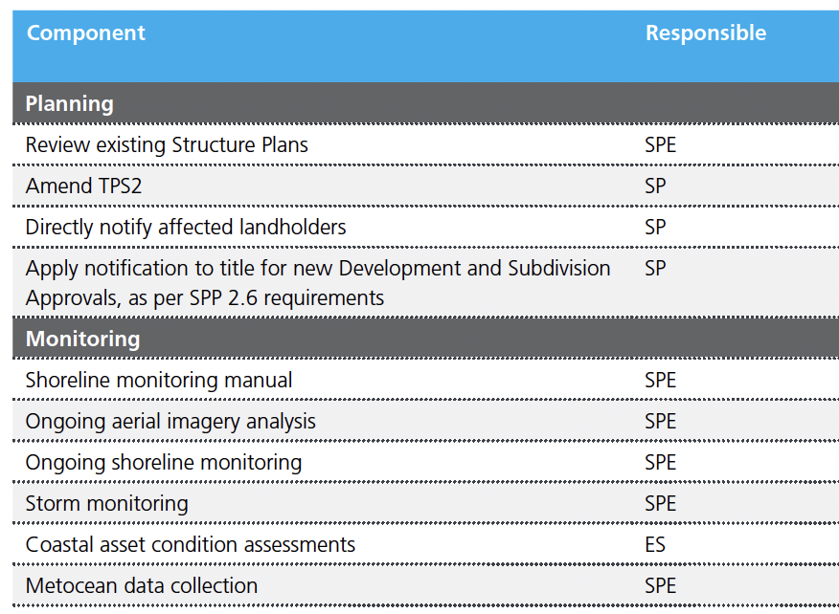
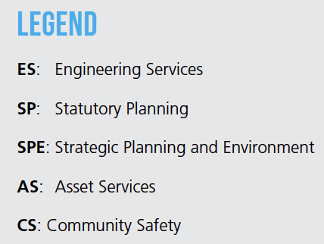
Source: City of Rockingham
Notes:
This extract illustrates a table version of some of the options described and then which ‘directorate’ will be responsible for managing this task.
This example from Rockingham reflects the use of the more specific directorate rather than the generic ‘organisation’. This also reflects a more recent move to remove external stakeholders for leading the responsibility for delivery, where they are unlikely to prioritise actions in the same way as the LGA.
Feedback from stakeholders says this is critical for internal ownership of the document, and obligations within the budgeting and reporting cycles, even if there is staff turnover. Older CHRMAPs were typically silent on this detail, and actioning of recommendations has been significantly affected by staff turnover and lack of ownership.

Slide 36
The CHRMAP Guidelines say…
Planning Framework and Approval agencies
The template scope of works says:
Planning instrument requirements and amendments
Approval processes and requirements

Slide 37
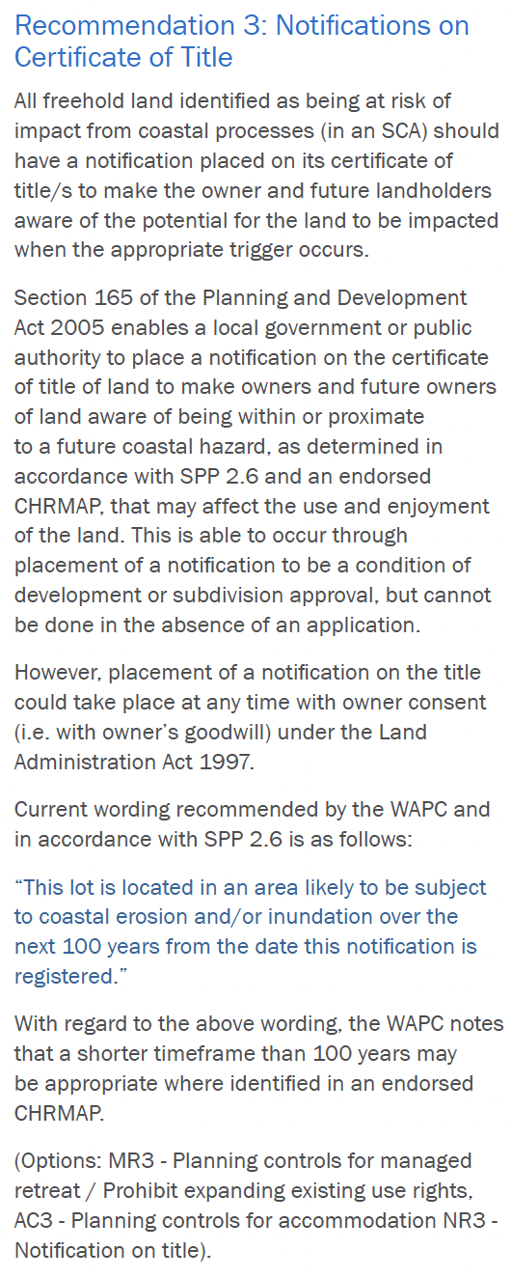
Source: Shire of Gingin
Notes:
What is required to implement is very varied for different options – some are one step e.g. write a letter notifying all owners in the hazard zone without any formal approval other than a decision of the administration to write and distribute the information. Some are more complex llke years worth of monitoring, detailed design, funding applications, raising of monies, environmental and planning approvals, and delivery.
Module 2 Training describes the number of different agencies and the WA Coastal Zone Strategy further expands on this and links the various Acts and legislation that would govern it.
This example shows the legislation under which the notification may occur, describes the limits, and also what the notification should say. It foreshadows (supported by additional information in the CHRMAP) how the planning department would deal with the recommendation. Presumably it would then say that responsibility falls with the Planning directorate.
This will be described later, however, some stakeholders are seeking much more clarity post CHRMAP on the exact steps per recommendation, particularly where the recommendation is heavily engineering focussed. This may not be suitable for the CHRMAP, given the recommendation to make it clear and easy to read, however, there is merit in providing a more detailed plan as a follow on document or as an appendix.

Slide 38
The CHRMAP Guidelines say…
Triggers
The template scope of works says:
Trigger points for implementing risk management measures. Monitoring framework to determine if a trigger occurs

Slide 39
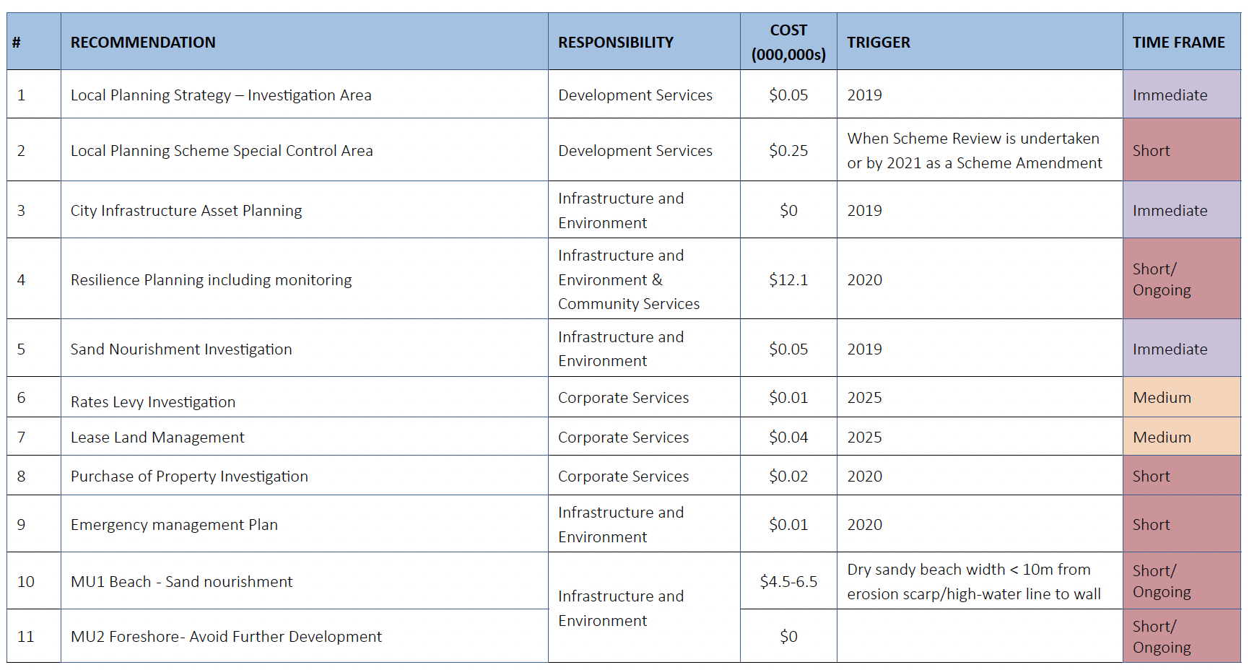
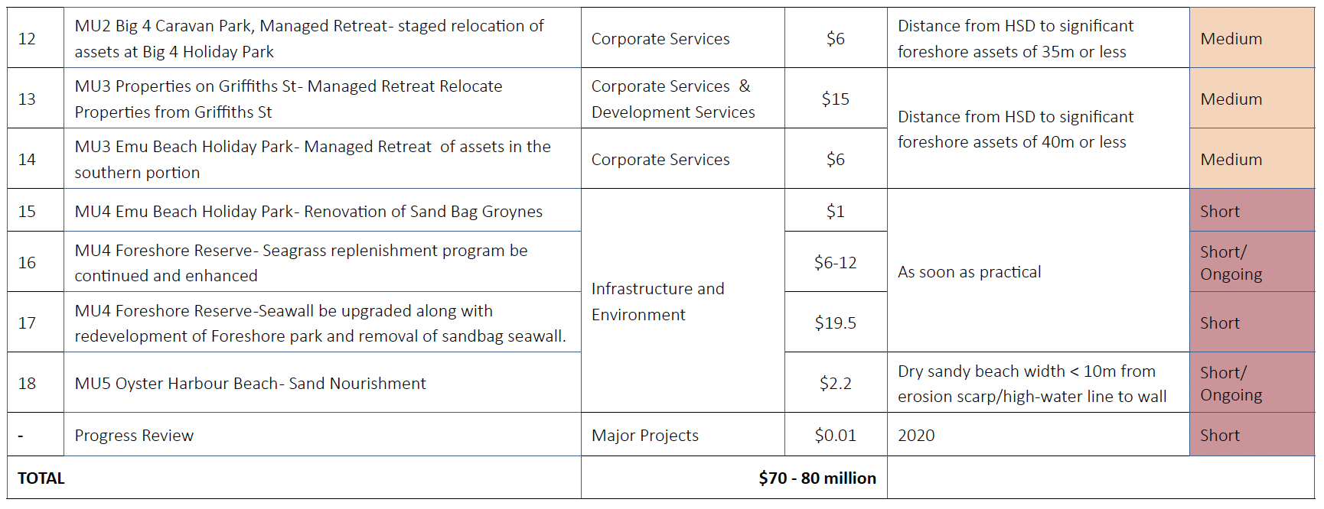
Source: City of Albany
Notes:
This table from the City of Albany provides an abridged version of the recommendations table, indicating triggers. In some cases these are a bit too specific vis-à-vis the comment I made earlier, as the triggers may well be passed by the time that the action can feasibly be implemented. But the addition of the Timeframe column does give further general indication.
You can see that triggers can be varied, depending on the adaptation option being recommended.

Slide 40
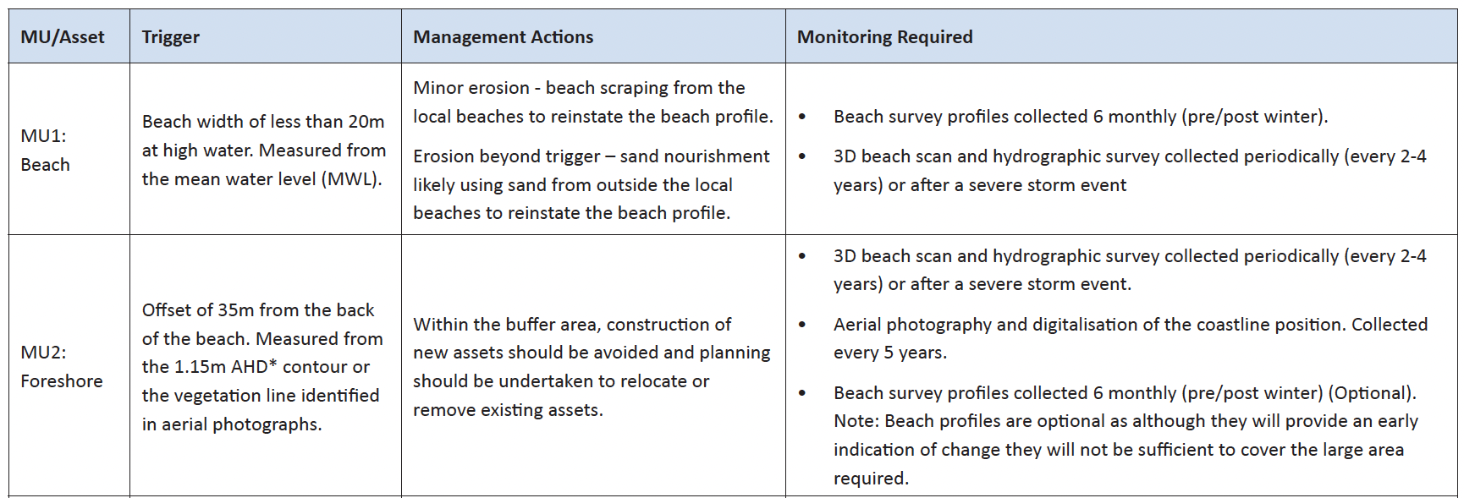
Source: City of Albany
Notes:
The recommendations in the Albany document was supported by a more detailed monitoring recommendation per management unit, followed with a detailed description of the monitoring types, where they would be completed, the description to help with scope definition, frequency, responsibility and review schedules.
This level of detail is considered highly desirable for users. In the last year, the City of Bunbury has added an even greater level of detail beyond this as an internal document to set a very clear pathway for the next 5 years, and remove any doubt as to priorities, tasks and responsibilities.

Slide 41
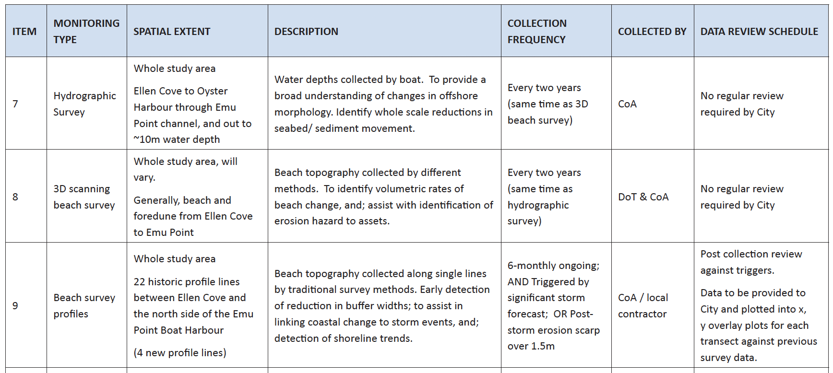
Source: City of Albany
Notes:
The recommendations in the Albany document was supported by a more detailed monitoring recommendation per management unit, followed with a detailed description of the monitoring types, where they would be completed, the description to help with scope definition, frequency, responsibility and review schedules.
This level of detail is considered highly desirable for users. In the last year, the City of Bunbury has added an even greater level of detail beyond this as an internal document to set a very clear pathway for the next 5 years, and remove any doubt as to priorities, tasks and responsibilities.

Slide 42
The CHRMAP Guidelines say…
Costs
The template scope of works says:
Costs associated with implementing selected risk management measures (capital and recurrent costs). Provide a detailed funding proposal, based on the Benefit Distribution Analysis, for implementation of chosen risk management measures

Slide 43
Most reviewed CHRMAPs included costs (as already illustrated);
however, the phrase ‘Provide a detailed funding proposal, based on the Benefit Distribution Analysis’ may not have yet been met for any CHRMAP reviewed
Notes:
This is likely due to the relatively short time of BDAs being introduced, and also the flexibility of the term ‘detailed’.
Stakeholder interviews noted the challenge of a detailed funding proposal resulting from a BDA, given that BDA is focussed on Accommodate and Protect pathways, most of which require more detailed investigation, engagement, clarification before they can be absolutely determined as the appropriate pathway.
Stakeholders also reflected a concern with the untested nature of BDA, and how it was possible to provide a level of detail suggested where there was no evidence that this could be followed. One stakeholder noted that even if BDA indicated distribution of costs to private parties, there would still need to be a co-contribution in either dollars or time/resourcing, and this co-contribution may not be palatable to the rest of the community/the Council
For reference, the Murray CHRMAP and draft Gingin CHRMAP both include Benefit Distribution Analysis and note the distribution amount for adaptation should accommodate or protect options be implemented.

Slide 44
The CHRMAP Guidelines say…
Performance Indicator
The template scope of works says:
What will be the indicators that demonstrate progress of implementation and effectiveness of the risk management measures?
Notes:
Each of the recommendations in the CHRMAP would be subject to review – which might include coastal monitoring, inundation studies, preliminary investigations and concept design, nourishment, planning measures etc – whatever is in the Implementation Plan.
Review could assess whether tasks had been initiated, completed etc.
However…. Next slide

Slide 45
Source: City of Albany
Source: Shire of Gingin
Notes:
As you can see from this page, there are few examples that include their own performance review. Nearly all examples include a review of the CHRMAP at either a 5 year or 10 year interval, where, presumably, some audit would be complete. However, it would be desirable for more LGA’s to undertake performance review of actual implementation tasks at shorter intervals.
This is not the same as reviewing the effectiveness of implemented risk management measures; which may be too detailed for the early development of a CHRMAP. However, one would assume that ongoing monitoring after implementation of an adaptation response would achieve this, including Protection Structure Audits of those same measures. Anecdotally this occurs on some projects, but not all.
Effectiveness would need to measure how the option responded to its intended purpose; e.g. did it reduce the erosion rate, inundation rate, was maintenance reduced, did the environment recover, was the community made more aware.
Over time this could be more explicitly described (e.g. we have done some work with strategic community plans that have review templates)

Slide 46
The CHRMAP Guidelines say…
Communication and Monitoring
The template scope of works says:
Who will need to be informed during and at completion of implementation of the risk management measures and how will the implementation be monitored and how frequently?
Notes:
The term ‘monitoring’ may be repetitive given earlier tasks, however, in the context of future projects and ongoing work, LGAs should at least consider how to continue ongoing communications.

Slide 47

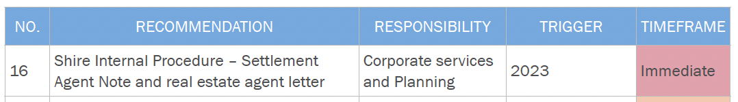
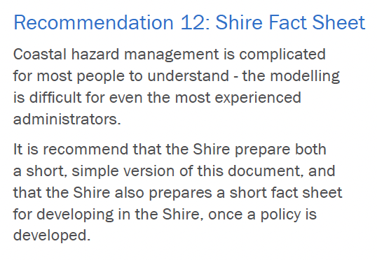
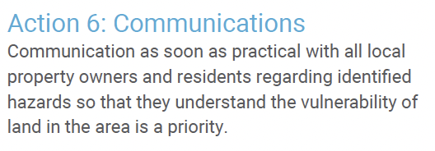
Source: Town of Cambridge
Source: Shire of Gingin
Notes:
A number of more recent CHRMAP include specific need for communication to the community more broadly and some key users more specifically. This is beyond the normal ‘publishing’ of the document on your website!

Slide 48
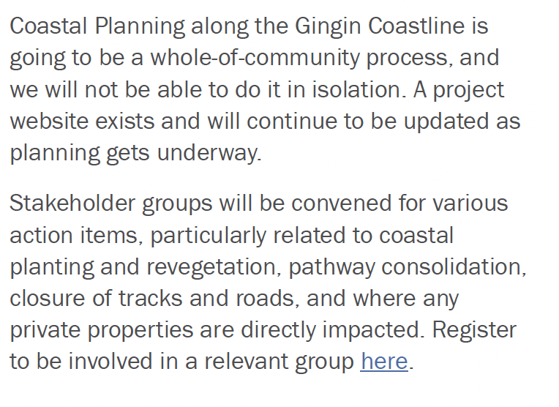
Source: Shire of Gingin

Slide 49
The CHRMAP Guidelines say…
Gannt chart
Medium to long term implementation
Land Use Planning Instruments
Discretionary Decision-Making and the Precautionary Principle
Funding Implementation

Slide 50
The CHRMAP Guidelines say…
Gannt chart
The template scope of works says:
As part of the short-term implementation plan, it can be helpful to formulate a Gantt chart .
Of particular importance in the short-term is the establishment of the necessary controls… other planning instruments… commencement of budgeting for required risk management measures

Slide 51
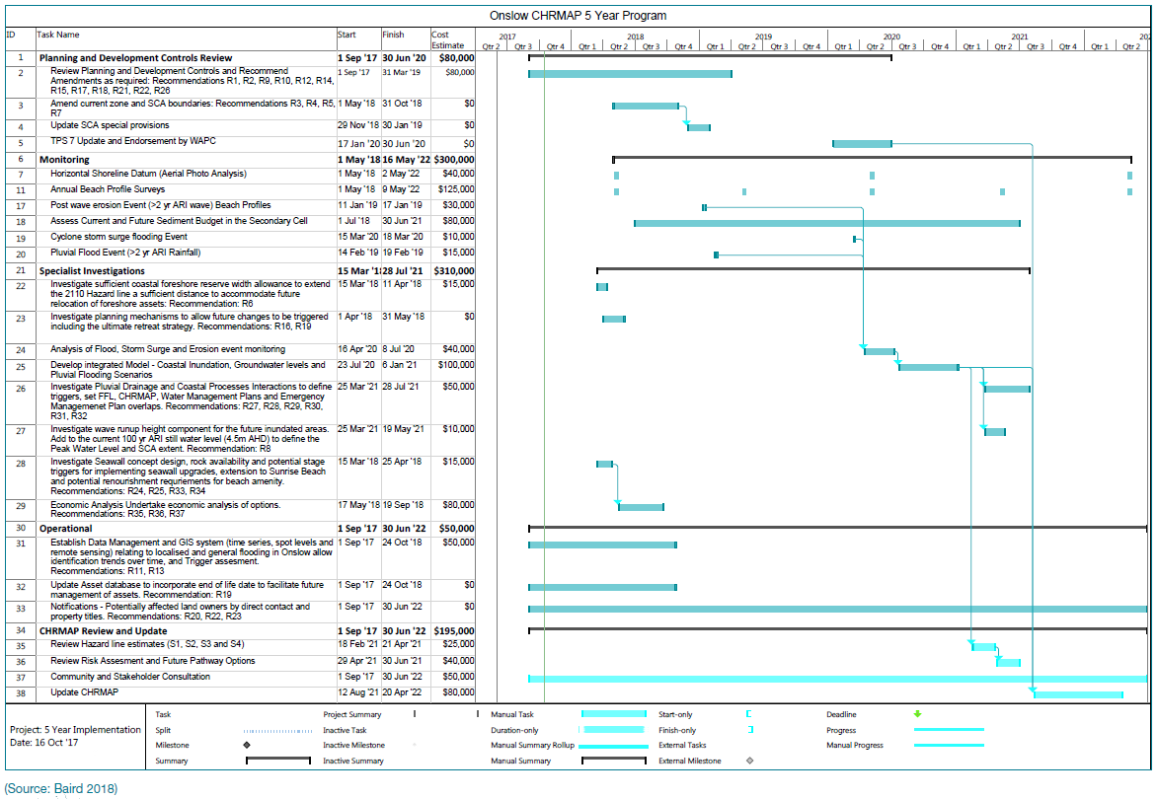
Source: Shire of Ashburton
Notes:
This example from the scope of works document, originally from the Shire of Ashburton illustrates an example gannt chart.
A number of examples already shown and discussed present this differently. Often the information in this gannt chart would be repeated many times to achieve the previous instructions – timing, responsibility, funding etc. There may be merit in considering consolidating all the information into this gannt chart, or to create a gannt chart as part of a separate much more detailed internal document for the Shire. The primary purpose for this tool would be to identify priority and/or necessary predecessors, which could also be done in a table format.
The use of a gannt may depend on end user preferences.

Slide 52
The CHRMAP Guidelines say…
Notwithstanding – the gannt chart or tabling exercise is excellent for:
Understanding steps and stages for delivering
Understanding predecessors
Setting a mindset for each action (how long, how many involved etc)
Notes:
Prioritising actions and recommendations – when to do what

Slide 53
The CHRMAP Guidelines say…
Medium and long-term Implementation Plan
The template scope of works says:
Develop medium-term (25 – 50 years) and long-term (50 – 100 years) strategic implementation plans

Slide 54
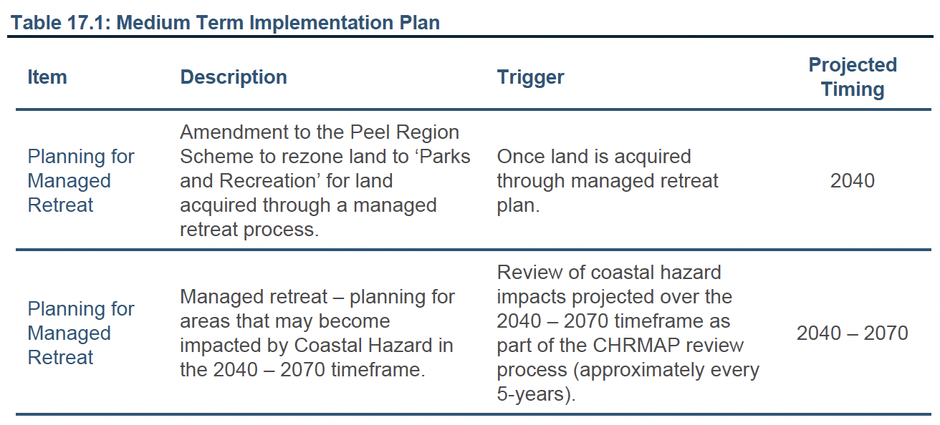
Source: Shire of Murray
Notes:
Great example of Planned and Managed retreat in the Geraldton CHRMAP, which provides three options for planned – see the next slide

Slide 55
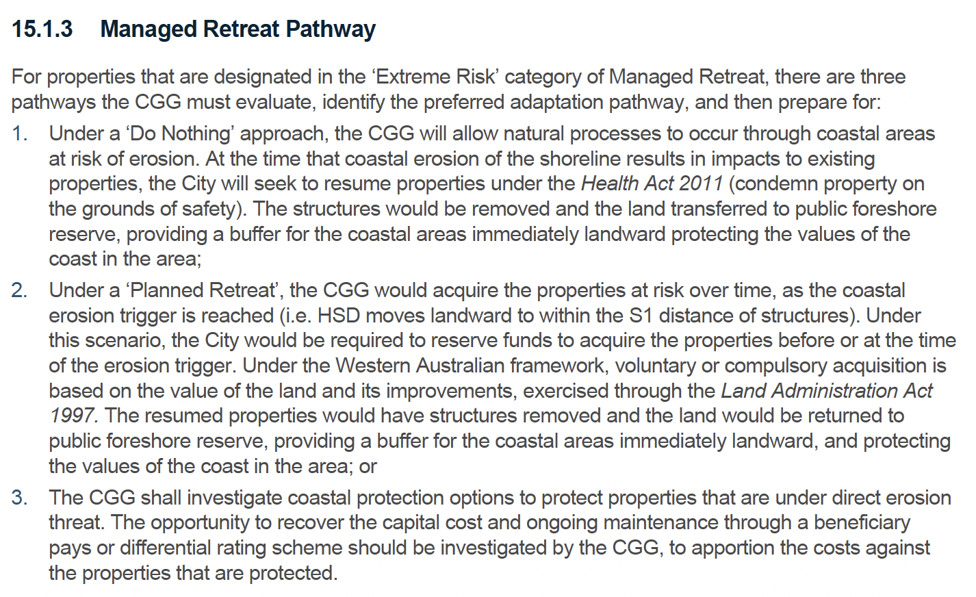
Source: City of Greater Geraldton

Slide 56
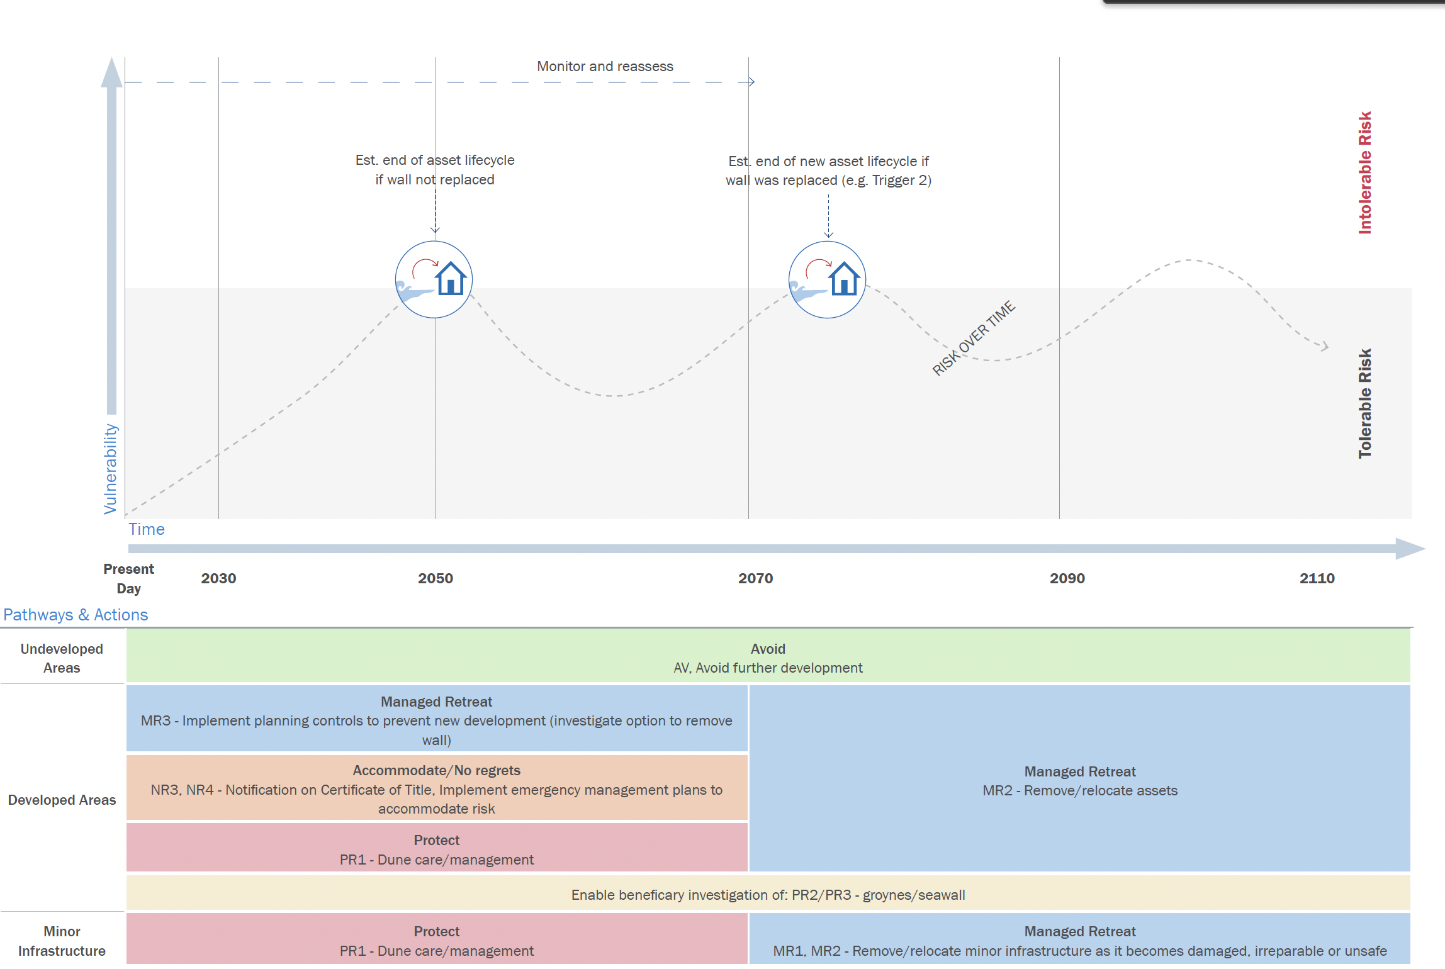
Source: Shire of Gingin
Notes:
This style for more graphically representation

Slide 57
The CHRMAP Guidelines say…
Land Use Planning Instruments
The template scope of works says:
The consultant is expected to provide details on proposed wording, implementation method/s, when to apply, relevant trigger points if required, and any other supporting information that may be needed for the decision-maker to implement risk management measures

Slide 58
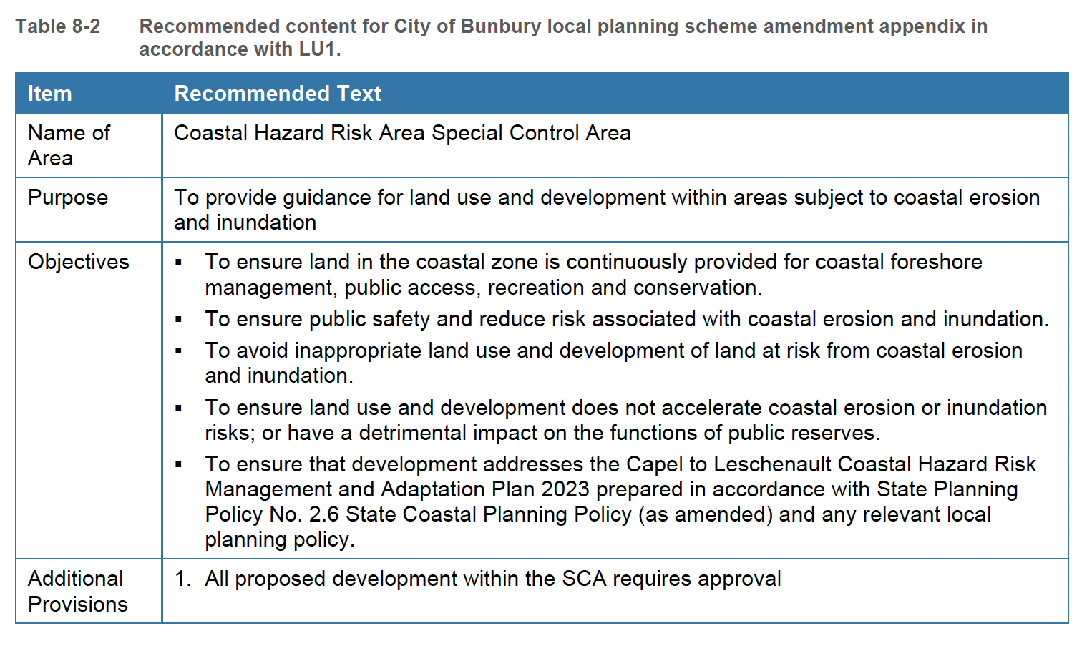
Source: City of Bunbury
Notes:
Appendix 4 of the CHRMAP guidelines refers to SCAs and provides some draft text

Slide 59
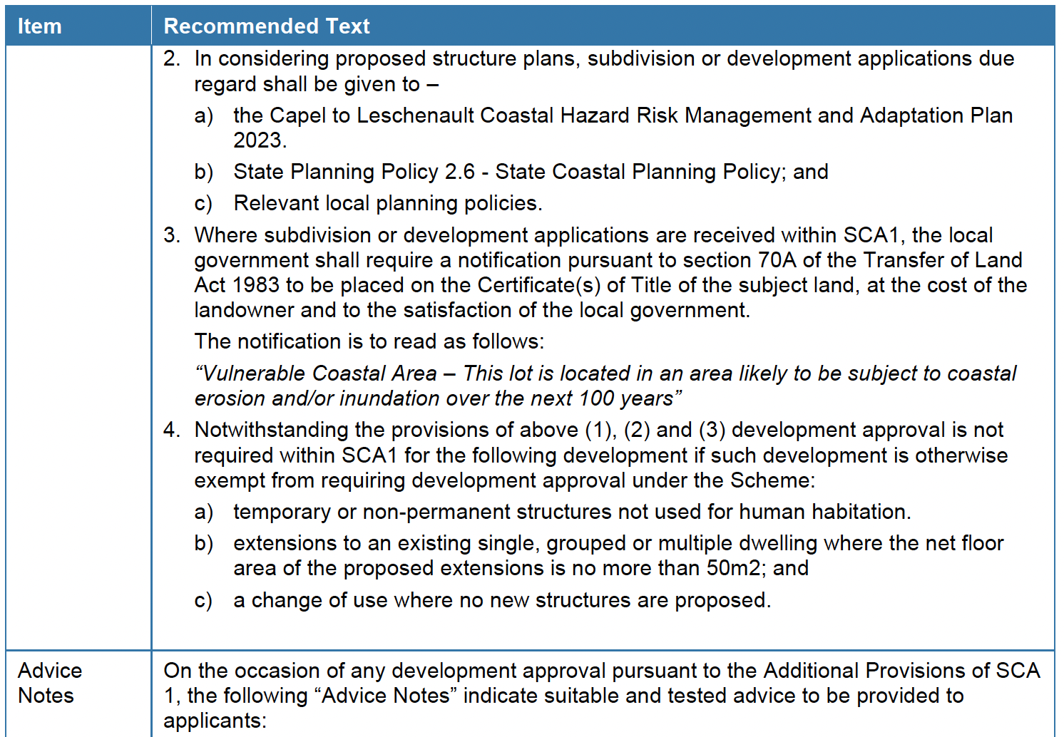
Source: City of Bunbury
Notes:
Now before I move to the next slide – note that the last two pages draw from the technical CHRMAP document which is full of detail. The information on the following slide is also included in the technical CHRMAP, however, the following slide is a screenshot of the summary CHRMAP. The above detail is not in the summary CHRMAP. This allows the summary CHRMAP Implementation Section to be concise for the intended audience at 10 pages, whilst the technical CHRMAP Implementation Section is 28.

Slide 60
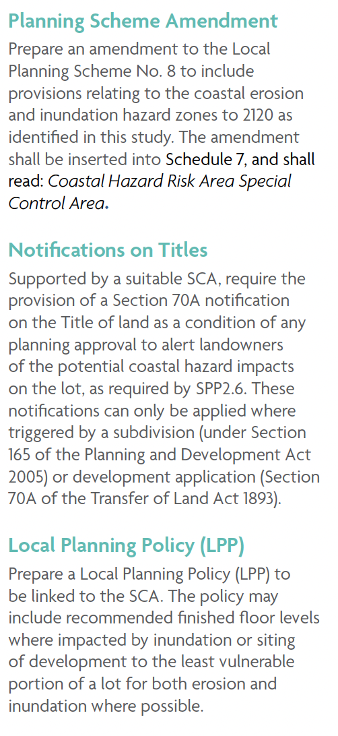
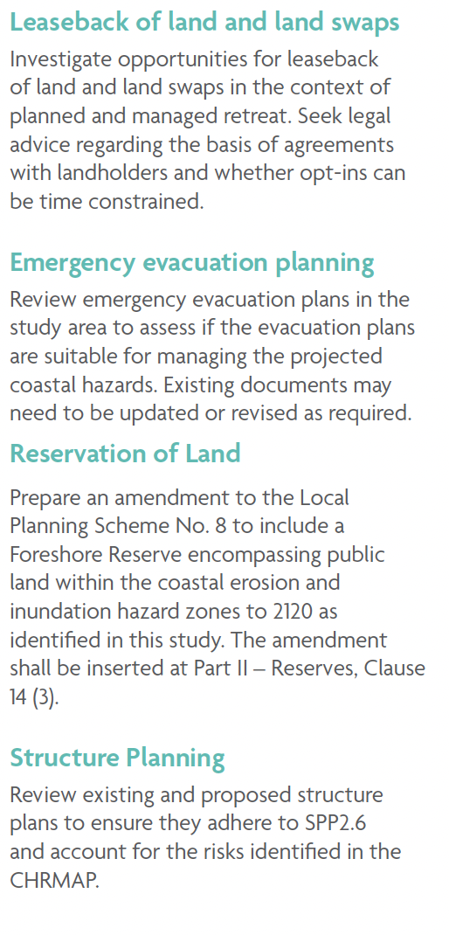
Source: City of Bunbury

Slide 61
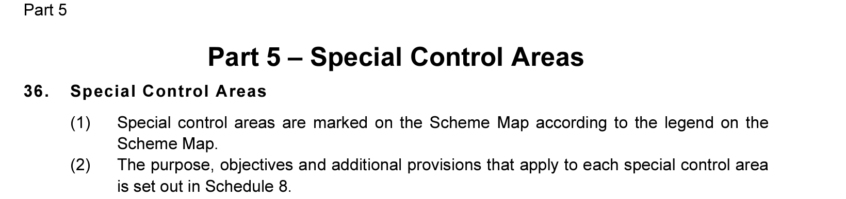
New City of Albany Scheme gazetted 27 February 2024
Source: City of Albany
Notes:
Appendix 2 of the Guidelines Appendix 4!
However, I recommend mining those LPSs that have been recently gazetted as these reflect the current language supported by the WAPC.

Slide 62
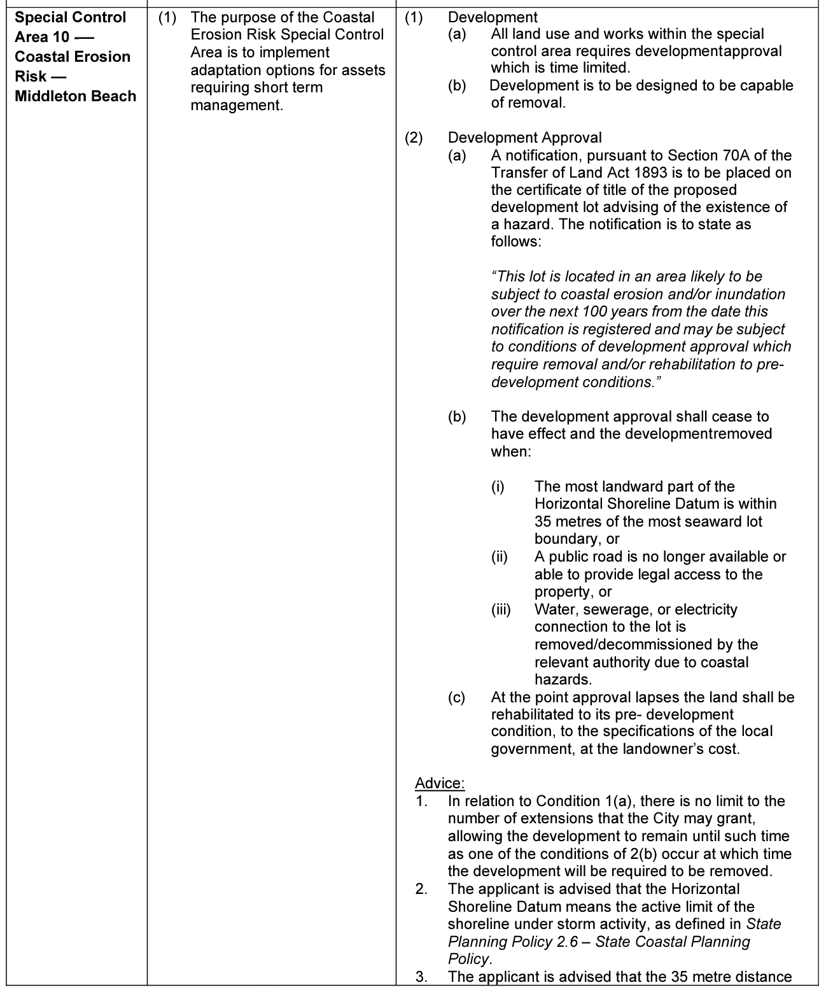
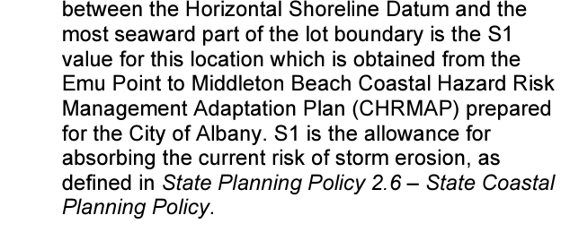
Source: City of Albany

Slide 63
The CHRMAP Guidelines say…
Discretionary Decision-Making and the Precautionary Principle
The template scope of works says:
Nothing – it is silent on this
The guideline says:
  … For strategic planning proposals, [subbies / DA’s] in coastal hazard areas, discretionary decision-making should involve the application of the precautionary principle contained in SPP 2.6 cl 5.11. […] warrants a conservative approach to decision-making when preparing a CHRMAP.
Notes:
Planning decisions must be made on the merit of a proposal and include holistic consideration of planning issues. For strategic planning proposals, subdivisions and development applications in coastal hazard areas, discretionary decision-making should involve the application of the precautionary principle contained in SPP 2.6 cl 5.11. The outcome of this policy measure means that the potentially serious risk associated with coastal hazards to people, property and infrastructure warrants a conservative approach to decision-making when preparing a CHRMAP and considering land use planning instruments that will assist the decision-maker to implement the CHRMAP.
I have yet to find a CHRMAP that specifically mentions this element of the guideline.

Slide 64
The CHRMAP Guidelines say…
Funding Implementation
The template scope of works says:
Identify revenue-raising mechanisms recommended, and governance framework through which such revenue is to be raised
The consultant will also undertake a BDA to assist in apportioning the costs

Slide 65
Best case studies for funding sections…
The CHRMAP Guidelines themselves
WA Coastal Zone Strategy
Murray CHRMAP – page 181
Gingin CHRMAP – page 152
Bunbury Summary CHRMAP – page 53
These documents also include elements of BDA
Notes:
The sections are long and text heavy – no screen shots here…

Slide 66
Funding sources
Operating Budget and General Rates (Busselton example)
Specified Area Rate (Murray), Levies
Beneficiary pays (no formal example yet)
  May include levies for visitors
  Developer contributions
Notes:
I think what other LGS are doing to raise money internally is going to be of most interest to the LGs.
The majority of the grants require 50% co-contribution so even if they are applying for grants they need to work out how to fund the 50% contribution.
See module 3 for more info about BDA’s.

Slide 67
Funding sources
  State Grants
  Lotterywest Grants (Lotterywest)
  Royalties for Regions (DPIRD – see the local Development Commission)
  State Natural Resource Management Grants (NRM)
  Riverbank Grants Scheme (DBCA) (works on the Swan & Canning Estuary)
  Growing Regions Program (formerly Building Better Regions Fund) (regional and rural areas)

Slide 68
Funding sources
CoastWA Grants –
  Coastal Adaptation and Protection (CAP) grant (Design, monitoring, data collection & construction)
  Hotspot Coastal Adaptation and Protection (H-CAP) (For relevant identified coastal hotspots)
  Coastwest grants (Can fund softer works, but not capital construction)
  Coastal Management Plan Assistance Program (CMPAP) (Planning related projects, including options assessment – not construction)
WALGA can also assist local governments with facilitating CoastWA funding applications
Notes:
24/25 all closed

Slide 69
Funding sources
Federal
Disaster Ready Fund
National Disaster Risk Reduction grants
Notes:
DRF is $200million per year for five years – but divided between all states and territories and across fields such as bush fire, stormwater, evacuation centres and community resilience strategies

Slide 70
Funding equity
One of the biggest challenges
Cost for coastal management can be very high
Beneficiaries may not understand the total cost impost to the state - taxpayers
WA Coastal Zone Strategy is very clear
Notes:
Will point back to the Geraldton example

Slide 71
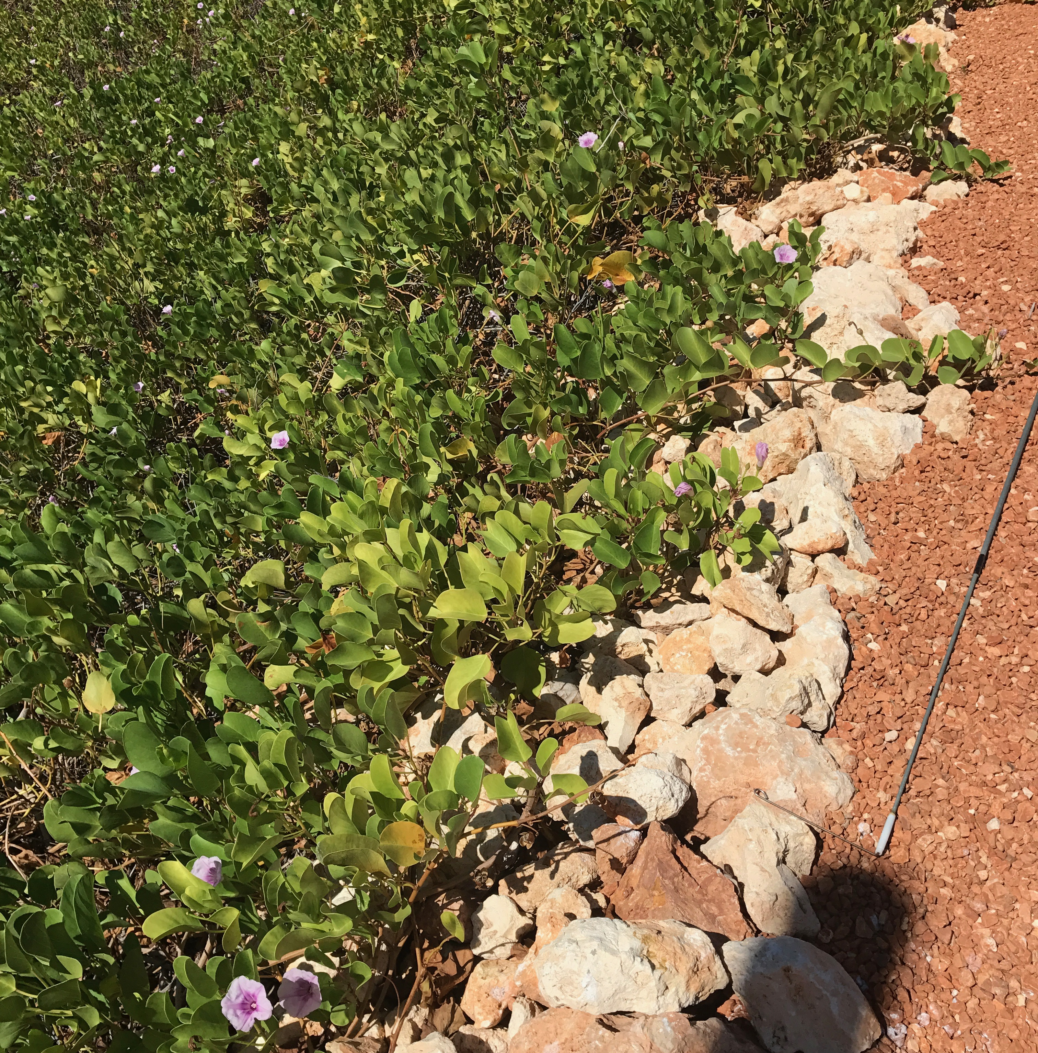
CASE STUDY SUMMARY

Slide 72
CHRMAP’s reviewed – 21 (2014 – 2024)
None met all of the guideline / specifics from the scope of works
More than half remained silent on who was responsible or how it would be funded
Good news – the older they are, the more likely they are to have missed some of the guideline requirements!
More recent examples are often the longest
Notes:
We have looked at 20 different CHRMAP from the last 10 years, ranging from a glorious but vague 6 pages through to a whopping 76. The average length is 20 pages.
50% included a specific short term plan/ or framed actions in a simple way
30% did not include responsibility or timing
30% did not include responsibility
60% were silent on costs or directly linking funding sources to a specific project

Slide 73
CHRMAP’s reviewed – 21 (2014 – 2024)
None of the CHRMAPs reviewed followed the scope of guideline document strictly…
Variations:
Start at management unit recommendations and finishing with funding (possible more like scope document)
Start at planning and monitoring actions and finishing with CHRMAP review
Put planning and funding in a previous chapter – keep the implementation chapter for recommendations
Notes:
Broome, Murray, Bunbury
The variation in this section is vast. It reflects both the author and the sponsor needs for the document (the client).
Interviews suggested that the more clear the recommendations (who what where when why) the more likely to get done. More recent examples are best.
Most stakeholders reflected on the need to represent hard protect options as being longer term and subject to investigations – lead with short term and soft options and build community understanding over time.
Particularly to manage expectations because hard options often require much more co-funding and will be necessarily limited by budget. These options may effectively be do-nothing options, if support from grants or beneficiary contribution are not forthcoming.

Slide 74
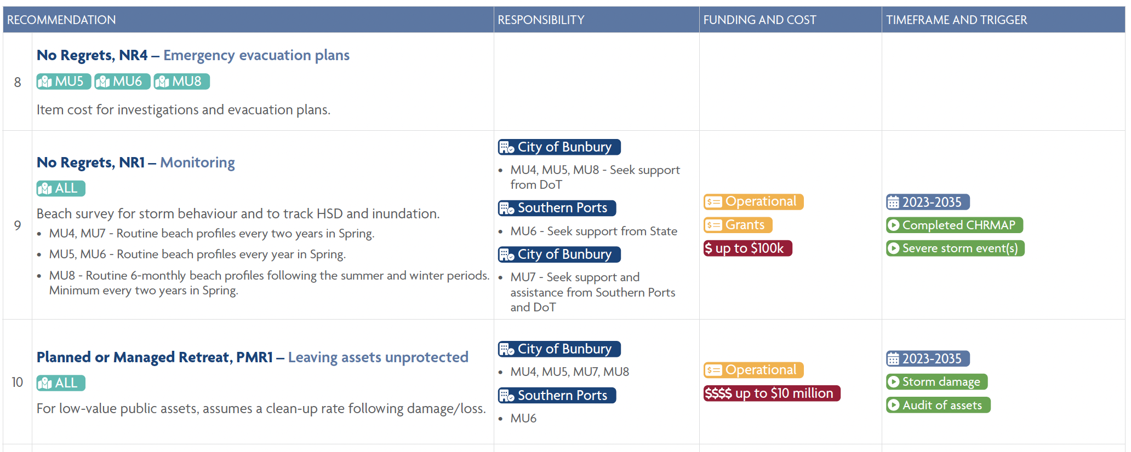
Source: City of Bunbury

Slide 75
CHRMAP’s reviewed – 21 (2014 – 2024)
What this tells us is that the development of this section is evolving
The examples referenced in this presentation each have excellent elements
The best examples have a technical document and an easier to read version

Slide 76
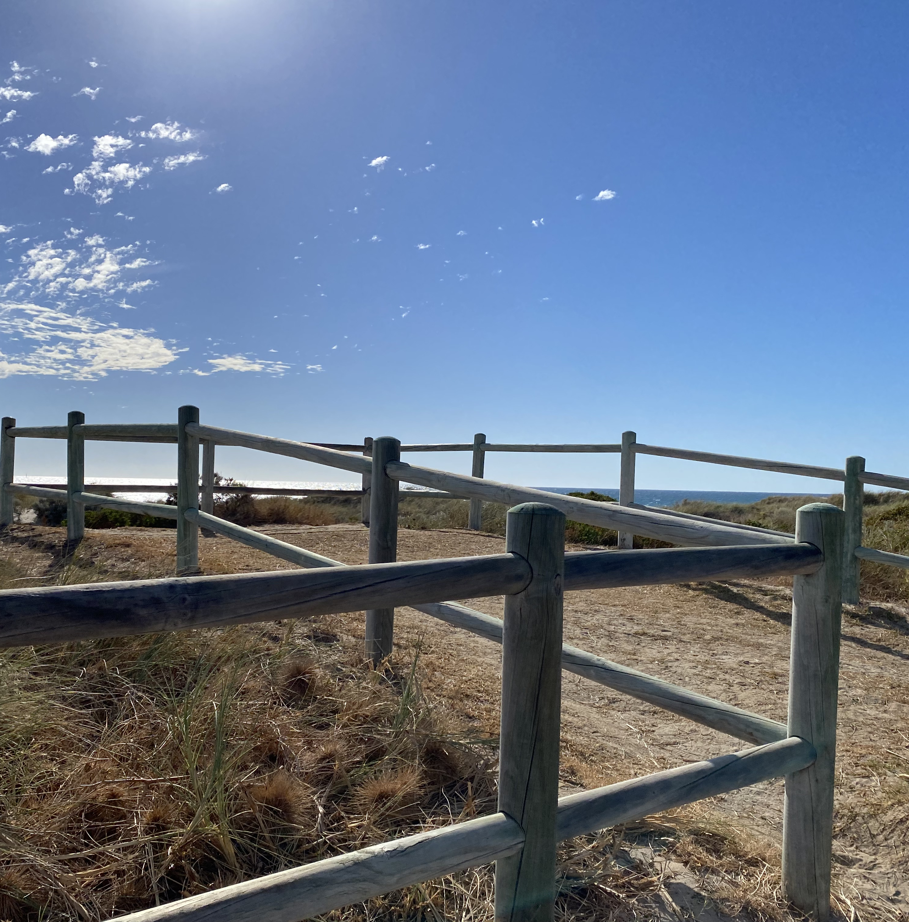
COMMON ACTIONS

Slide 77
Common CHRMAP Actions - Planning
Notifications on Title*
Limited planning consents*
Structure Plan and Foreshore Management Plan reviews
Asset Audit / Management Plan
Emergency evacuation planning
Notes:
I have attempted to make this in a reasonable time order that can be achieved

Slide 78
Common CHRMAP Actions - Planning
Local Planning Strategy review
Scheme - Special Control Area (avoid further development)*
Local Planning Policy (supporting SCA)*
Reservation of land
Managed retreat planning

Slide 79
Common CHRMAP Actions - Investigations
Sand Source Investigations
Rock Source Investigation
Terrestrial flood and groundwater implications
Geotechnical
Survey (LiDAR, DEM)
Bathymetric survey
Metocean data
Leaseback and land swap investigations

Slide 80
Common CHRMAP Actions - Monitoring
Protection Structure Audit
Routine beach and dune surveys
Corresponding monitoring photos at the same time as beach surveys

Slide 81
Common CHRMAP Actions – Protect
Delivering options already designed
Further investigations and monitoring (see previous slides)
Feasibility studies
Detailed design and costing of future protect measures
Dune rehabilitation plans and planting programs
Manage beach access*

Slide 82
Common CHRMAP Actions - Funding
Rates levy / Specified Area Rate investigation
Further cost benefit or benefit distribution analysis
Engagement with community on funding options specifically (all ratepayers)
Grants and funding*
Notes:
Noting that grants are not guaranteed and 50% co-contribution often

Slide 83
Common CHRMAP Actions - Communications
Communication – letter to all properties and organisations within the hazard zone*
Advice to Real Estate and Settlement Agents (Land Purchase Inquiry)
Fact Sheets, web portal
Signage and education strategies
Coastal Reference Group
Other ongoing engagement
Notes:
Also in time order

Slide 84
Common CHRMAP Actions - Reviews
Progress Review
CHRMAP review

Slide 85
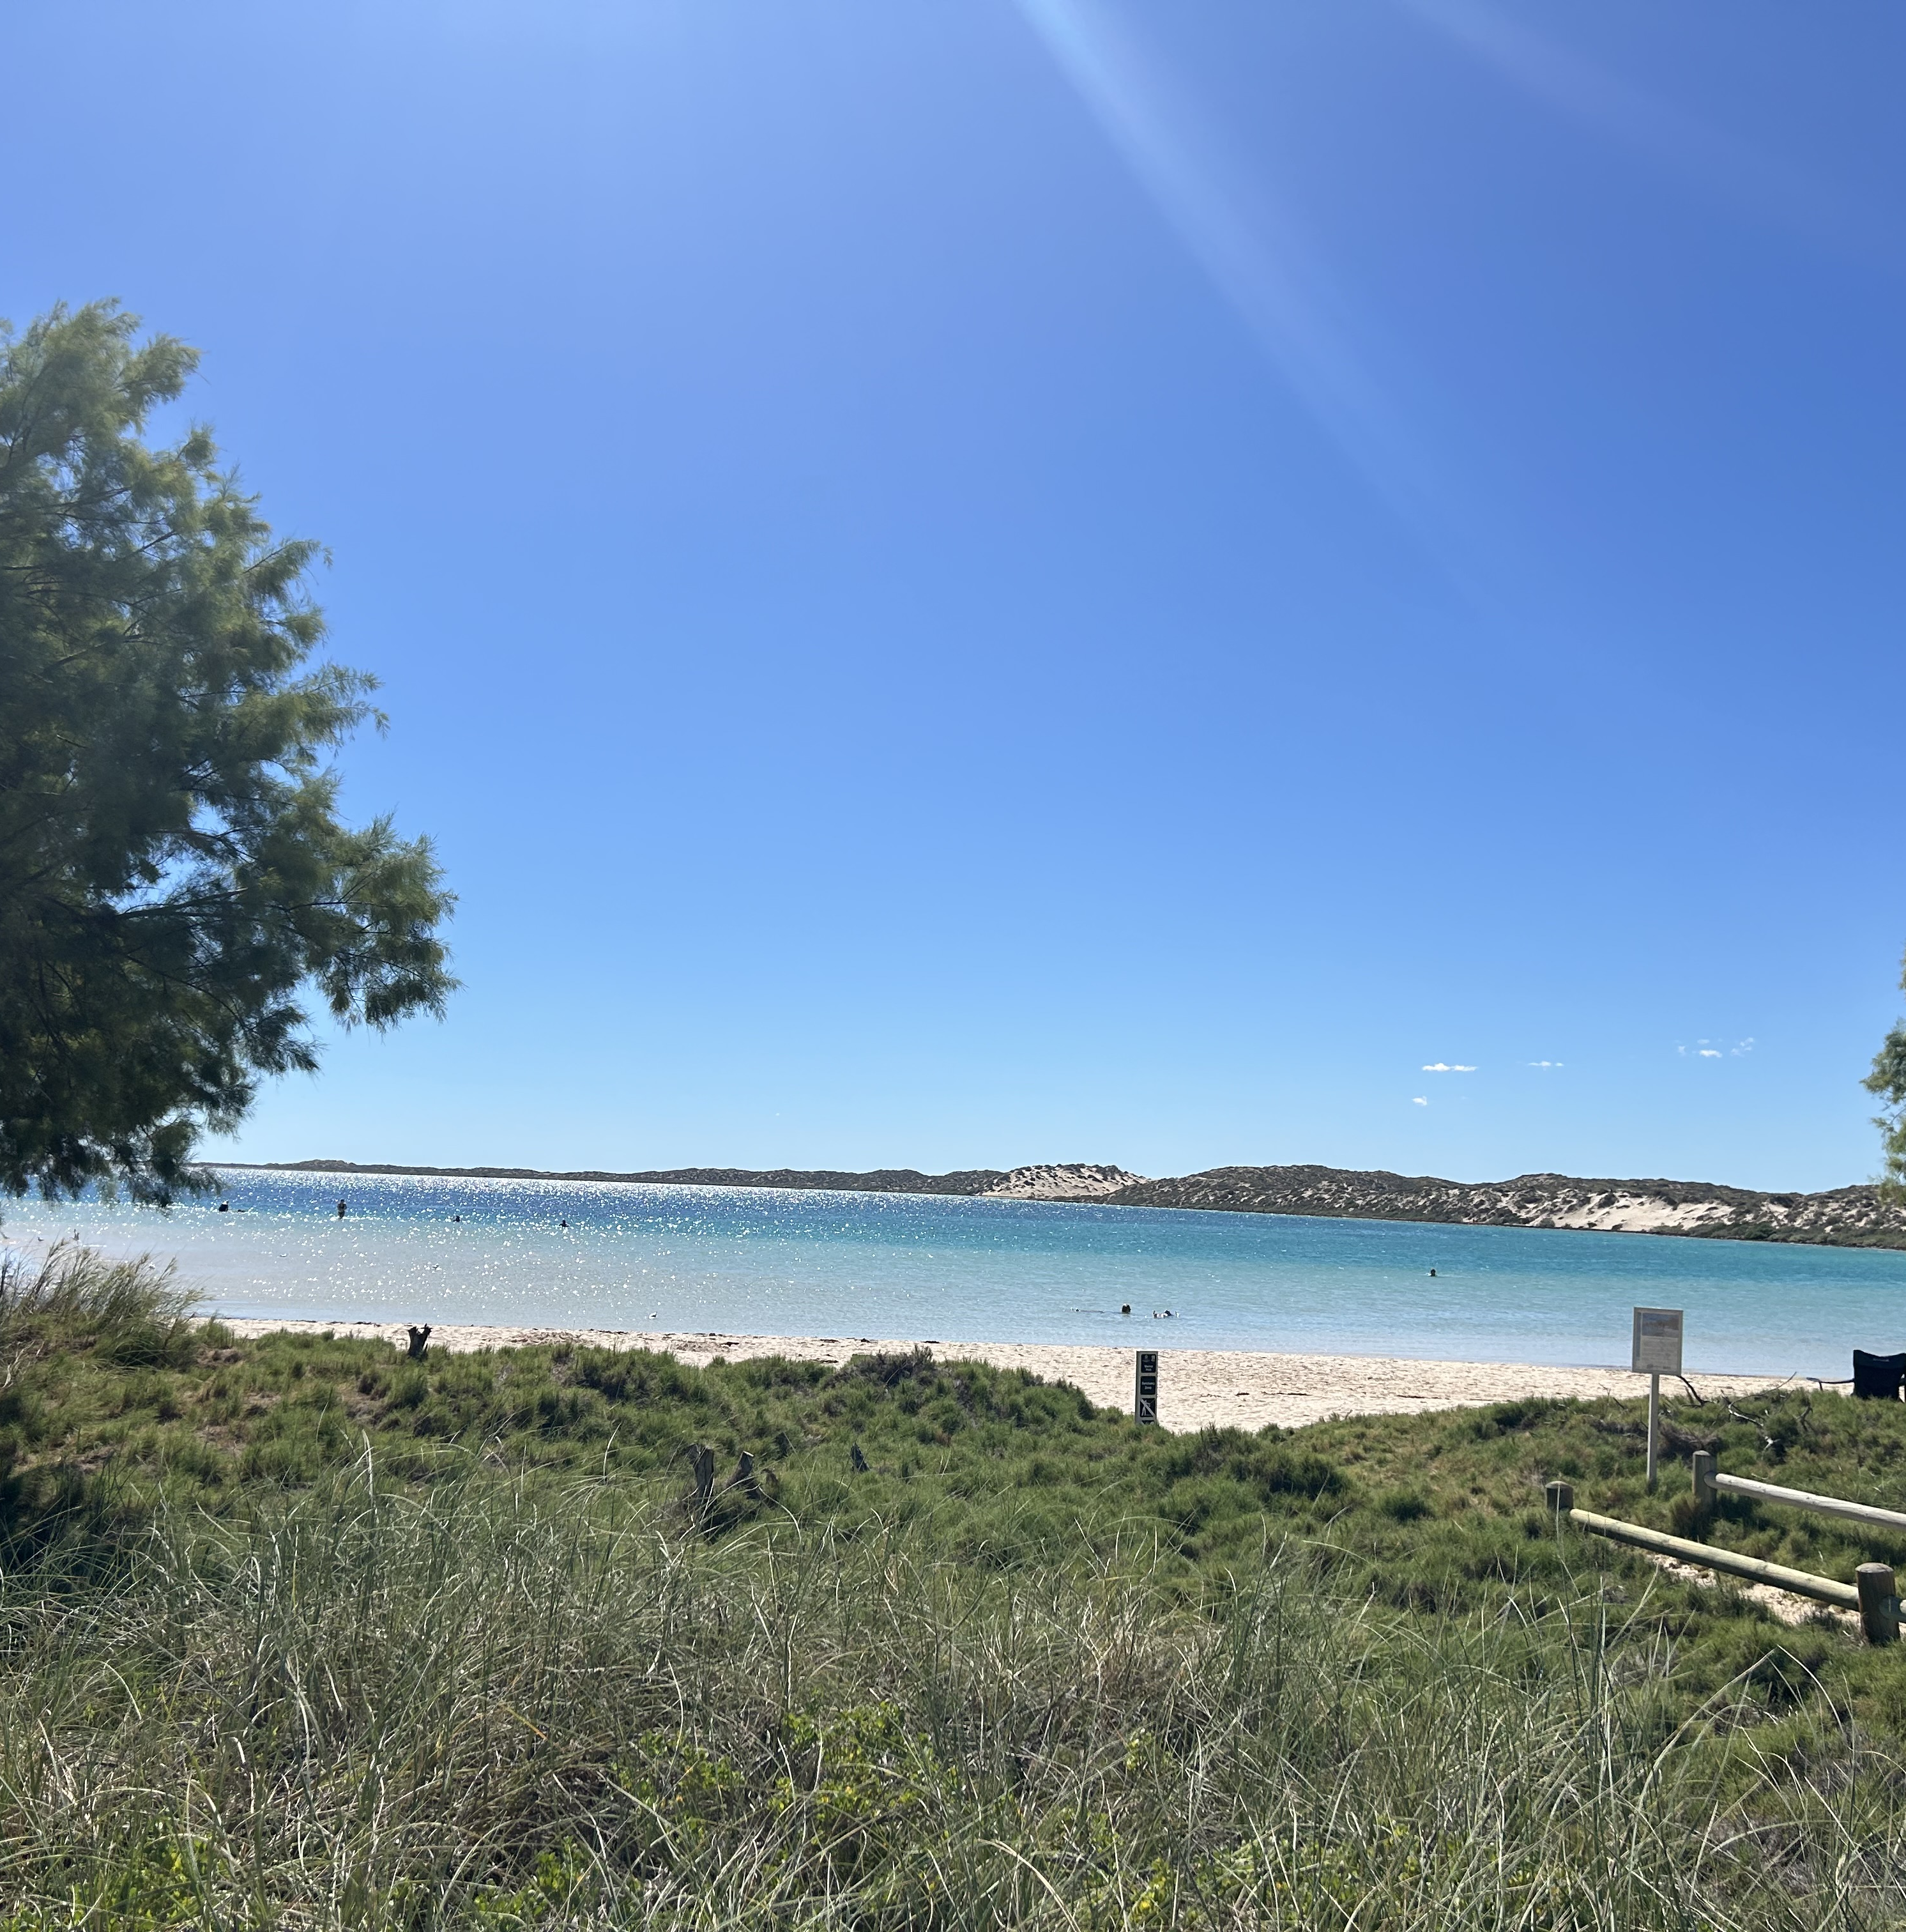
SUCCESS STORIES & SUGGESTIONS

Slide 86
Who has done what
Joondalup, Gingin and Albany – Notifications on Titles
Joondalup – Property Investigation Report notification in place for settlement agents and the public (if accessed)
Murray – partnership with UWA for monitoring (Master of Environmental Engineering student)
Northern Beaches Alliance (Wanneroo, Joondalup, Stirling, Nedlands, Cambridge) – coastal monitoring applications and grants co-applied. Also considering student support
Busselton – long term rates levy and recent increase again
Notes:
Notifications - These have been successfully implemented and tested in court - EVENT BASED

Slide 87
Suggestions
Investment in asset audits over the long term help the case for large grants (Joondalup – Coastal and Estuarine Risk Mitigation Funding)
Set aside rates budget at the start so implementation actions are funded as the CHRMAP is finalised
Implementation is a bit easier if Elected Members are very involved from the start
Engage heavily with planners, parks, asset managers – lots of briefings at implementation stage – staff training

Slide 88
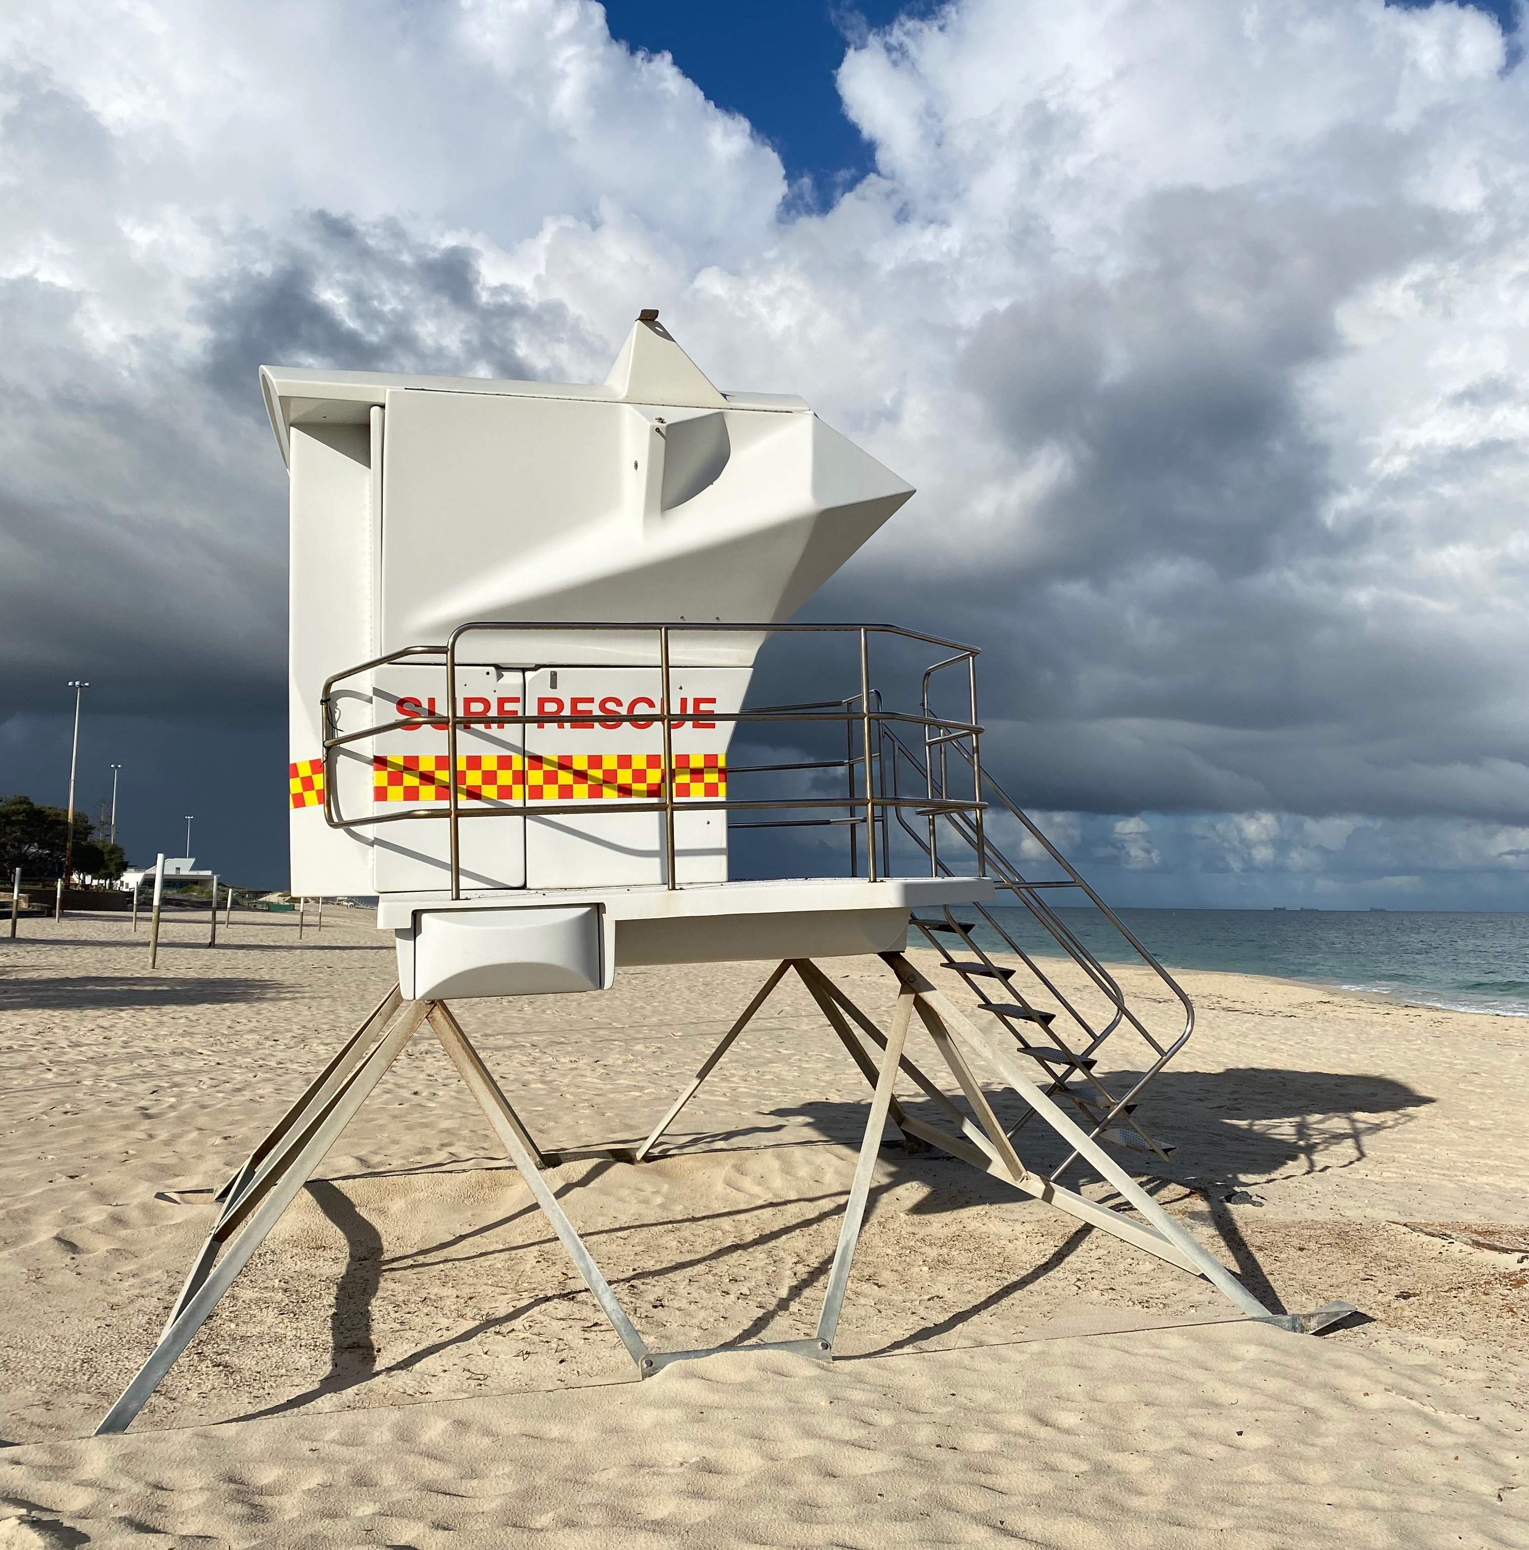
REFERENCES

Slide 89
References
CHRMAP’s and supporting documents from LGAs:
Albany
Augusta-Margaret River
Broome
Bunbury
Busselton
Cambridge
Cockburn
Cocos (Keeling) Islands (draft)
Dandaragan
Denham
Denmark
Geraldton
Gingin (draft)
Harvey
Joondalup
Karratha
Mandurah (Northern Beaches)
Murray
Onslow
Port Hedland
Rockingham

Slide 90
References
CoastWA and WALGA documents:
CoastWA Local Government Survey
WALGA Survey of Local Government Training Needs

Slide 91
References
SPP 2.6 and related documents:
https://www.wa.gov.au/government/publications/state-planning-policy-26-coastal-planning
https://www.wa.gov.au/government/document-collections/coastal-hazard-risk-management-and-adaptation-planning-guidelines
https://www.wa.gov.au/government/publications/wa-coastal-zone-strategy

Slide 92
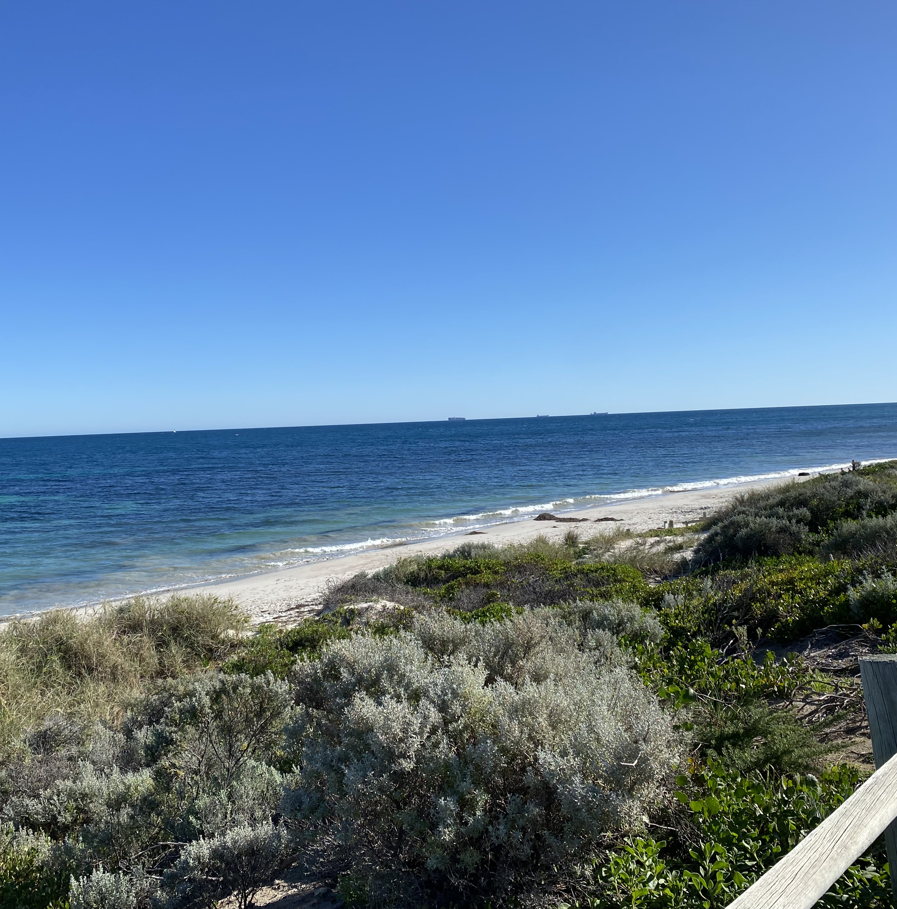
THANK YOU

